Slide 1
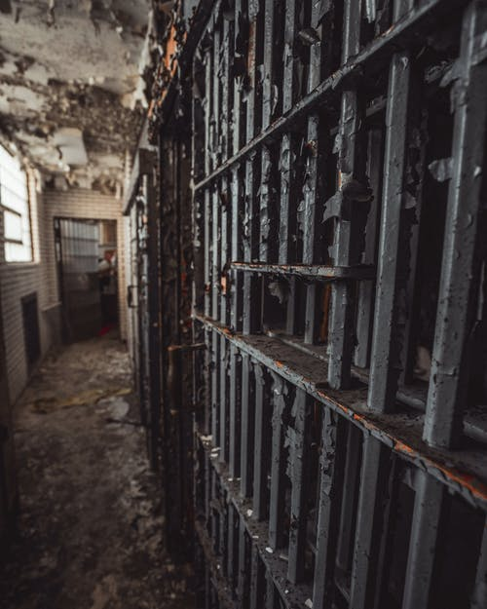
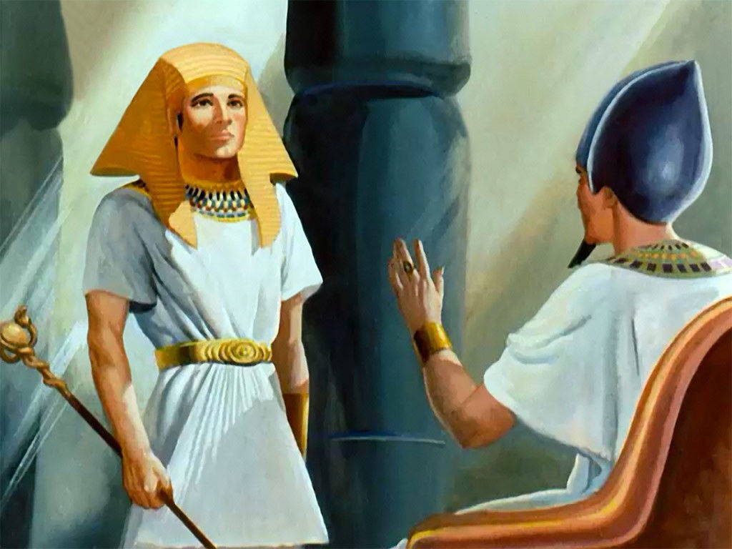
‘Joseph the Dreamer’
META-MORPHOSIS JUVENILE REHABILITATION PROGRAM ™
A young man thrown into prison for 13 years and surfaced Governor of Egypt.
A story of attitude and forgiveness.
Class 6
Notes:
Narration: Bible Study 6

Slide 2
“From a Dreamer to Governor”
Notes:
Narrative:

Slide 3
Pharaoh honors Joseph and places him in charge. “…only in regard to the throne will I be greater than you.”
Notes:
Narrative
TEXT: Genesis 41 37-57
Joseph’s Rise to Power
So the advice was good in the eyes of Pharaoh and in the eyes of all his servants. And Pharaoh said to his servants, “Can we find such a one as this, a man in whom is the Spirit of God?” Then Pharaoh said to Joseph, “Inasmuch as God has shown you all this, there is no one as discerning and wise as you. You shall be over my house, and all my people shall be ruled according to your word; only in regard to the throne will I be greater than you.”
And Pharaoh said to Joseph, “See, I have set you over all the land of Egypt.” Then Pharaoh took his signet ring off his hand and put it on Joseph’s hand; and he clothed him in garments of fine linen and put a gold chain around his neck. And he had him ride in the second chariot which he had; and they cried out before him, “Bow the knee!” So he set him over all the land of Egypt. Pharaoh also said to Joseph, “I am Pharaoh, and without your consent no man may lift his hand or foot in all the land of Egypt.” And Pharaoh called Joseph’s name Zaphnath-Paaneah.
And he gave him as a wife Asenath, the daughter of Poti-Pherah priest of On. So Joseph went out over all the land of Egypt.
Joseph was thirty years old when he stood before Pharaoh King of Egypt. And Joseph went out from the presence of Pharaoh, and went throughout all the land of Egypt.

Slide 4
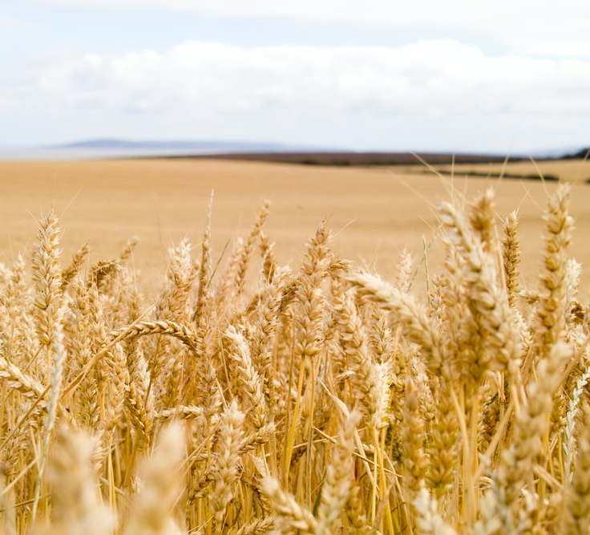
There were 7 plentiful years that Joseph gathered crops
Notes:
Narrative
Now in the seven plentiful years the ground brought forth abundantly. So he gathered up all the food of the seven years which were in the land of Egypt, and laid up the food in the cities; he laid up in every city the food of the fields which surrounded them. Joseph gathered very much grain, as the sand of the sea, until he stopped counting, for it was immeasurable.

Slide 5
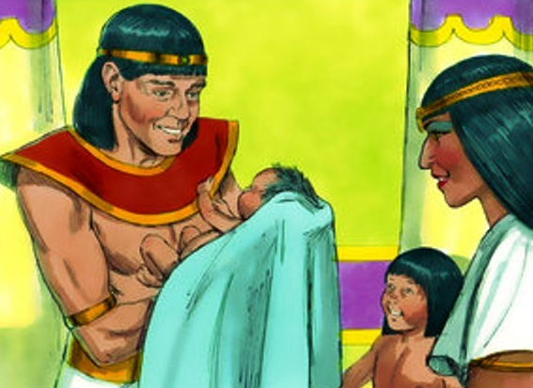
Joseph had 2 children, Manasseh and Ephraim
Notes:
Narrative
And to Joseph were born two sons before the years of famine came, whom Asenath, the daughter of Poti-Pherah priest of On, bore to him. Joseph called the name of the firstborn Manasseh: “For God has made me forget all my toil and all my father’s house.” And the name of the second he called Ephraim: “For God has caused me to be fruitful in the land of my affliction.” Then the seven years of plenty which were in the land of Egypt ended, and the seven years of famine began to come, as Joseph had said.

Slide 6
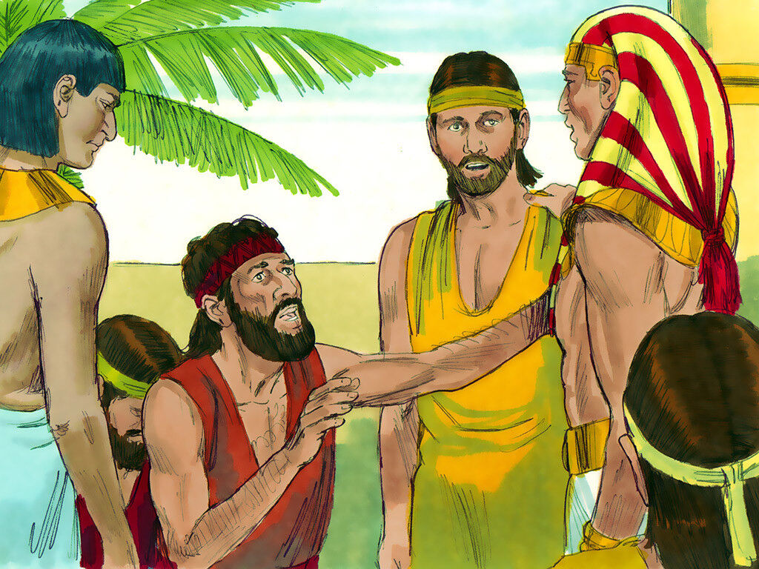
The famine followed and the people of Egypt came to Joseph for help
Notes:
Narrative
The famine was in all lands, but in all the land of Egypt there was bread. So when all the land of Egypt was famished, the people cried to Pharaoh for bread. Then Pharaoh said to all the Egyptians, “Go to Joseph; whatever he says to you, do.” The famine was over all the face of the earth, and Joseph opened all the storehouses and sold to the Egyptians. And the famine became severe in the land of Egypt. So, all the countries came to Joseph in Egypt to buy grain, because the famine was severe in all lands.

Slide 7
Group Discussion
1. Pharaoh was in awe of Joseph’s ability and wisdom. Joseph never went to college and neither did Cheryl Langford. What was the secret of Joseph’s wisdom?
2. What was God’s part in bringing Joseph to this point of his life?
3. What was Joseph’s part? (Attitude)
4. What was the most important virtue that Joseph had in order to be made Governor of Egypt? (He totally relied on God)
5. Why is that important?
Notes:
Narrative Group Discussion
Break into groups of 4 and discuss the following questions.
Please Note:
Only give them one question at a time, after they have had adequate time to discuss, move to the next question.
Come back to a whole group and re-ask the same questions and see if anyone wants to share their thoughts.

Slide 8
Group Discussion
6. God knows everything. We only see part of the picture. There will be times that God will ask us to do things we don’t understand. How can we get to the point of that total trust? (Prayer is the only way)
7. Why is reading your Bible important?
8. Joseph didn’t have a Bible. There was no such thing at that time and yet God still communicated him. What were some of the ways that God communicated with Joseph?
9. Joseph was a shepherd as a young man. He spent hours alone at night looking up into the sky. When was the last time you just laid awake and looked at the stars?
10. What do you think Joseph learned all those years?
11. Why would that be a good thing for you to do? (Quiet, Listening, etc.)

Slide 9
References
https://media.freebibleimages.org/stories/FB_Joseph_Dreams/overview-images/005-joseph-dreams.jpg?1613595442
https://media.freebibleimages.org/stories/FB_Joseph_Ruler/overview-images/004-joseph-ruler.jpg?1613595458
https://media.freebibleimages.org/stories/FB_Joseph_Reunion/overview-images/003-joseph-reunion.jpg?1613595463
https://images.unsplash.com/photo-1560329775-05b004e3ee48?ixid=MnwxMjA3fDB8MHxzZWFyY2h8Mnx8d2hlYXQlMjBmaWVsZHxlbnwwfHwwfHw%3D&ixlib=rb-1.2.1&w=1000&q=80
https://wwyeshua.files.wordpress.com/2014/10/005-joseph-ruler.jpg
https://images.pexels.com/photos/1687067/pexels-photo-1687067.jpeg?auto=compress&cs=tinysrgb&dpr=1&w=500
https://media.freebibleimages.org/stories/FB_Moody_Joseph/overview-images/032-moody-joseph.jpg?1613597252

Slide 10
Original Narrative
Notes:
Narrative:
TEXT: Genesis 41 37-57
Joseph’s Rise to Power
So the advice was good in the eyes of Pharaoh and in the eyes of all his servants. And Pharaoh said to his servants, “Can we find such a one as this, a man in whom is the Spirit of God?” Then Pharaoh said to Joseph, “Inasmuch as God has shown you all this, there is no one as discerning and wise as you. You shall be over my house, and all my people shall be ruled according to your word; only in regard to the throne will I be greater than you.”
And Pharaoh said to Joseph, “See, I have set you over all the land of Egypt.” Then Pharaoh took his signet ring off his hand and put it on Joseph’s hand; and he clothed him in garments of fine linen and put a gold chain around his neck. And he had him ride in the second chariot which he had; and they cried out before him, “Bow the knee!” So he set him over all the land of Egypt. Pharaoh also said to Joseph, “I am Pharaoh, and without your consent no man may lift his hand or foot in all the land of Egypt.” And Pharaoh called Joseph’s name Zaphnath-Paaneah.
And he gave him as a wife Asenath, the daughter of Poti-Pherah priest of On. So Joseph went out over all the land of Egypt.
Joseph was thirty years old when he stood before Pharaoh King of Egypt. And Joseph went out from the presence of Pharaoh, and went throughout all the land of Egypt.
Now in the seven plentiful years the ground brought forth abundantly. So he gathered up all the food of the seven years which were in the land of Egypt, and laid up the food in the cities; he laid up in every city the food of the fields which surrounded them. Joseph gathered very much grain, as the sand of the sea, until he stopped counting, for it was immeasurable.
And to Joseph were born two sons before the years of famine came, whom Asenath, the daughter of Poti-Pherah priest of On, bore to him. Joseph called the name of the firstborn Manasseh: “For God has made me forget all my toil and all my father’s house.” And the name of the second he called Ephraim: “For God has caused me to be fruitful in the land of my affliction.” Then the seven years of plenty which were in the land of Egypt ended, and the seven years of famine began to come, as Joseph had said.
The famine was in all lands, but in all the land of Egypt there was bread. So when all the land of Egypt was famished, the people cried to Pharaoh for bread. Then Pharaoh said to all the Egyptians, “Go to Joseph; whatever he says to you, do.” The famine was over all the face of the earth, and Joseph opened all the storehouses and sold to the Egyptians. And the famine became severe in the land of Egypt. So, all the countries came to Joseph in Egypt to buy grain, because the famine was severe in all lands.
STUDY GROUP QUESTIONS
Pharaoh was in awe of Joseph’s ability and wisdom. Joseph never went to college and neither did Cheryl Langford. What was the secret of Joseph’s wisdom?
What was God’s part in bringing Joseph to this point of his life?
What was Joseph’s part? (Attitude)
What was the most important virtue that Joseph had in order to be made Governor of Egypt? (He totally relied on God)
Why is that important?
God knows everything. We only see part of the picture. There will be times that God will ask us to do things we don’t understand. How can we get to the point of that total trust? (Prayer is the only way)
Why is reading your Bible important?
Joseph didn’t have a Bible. There was no such thing at that time and yet God still communicated him. What were some of the ways that God communicated with Joseph?
Joseph was a shepherd as a young man. He spent hours alone at night looking up into the sky. When was the last time you just laid awake and looked at the stars?
What do you think Joseph learned all those years?
Why would that be a good thing for you to do? (Quiet, Listening, etc.)

