Slide 1
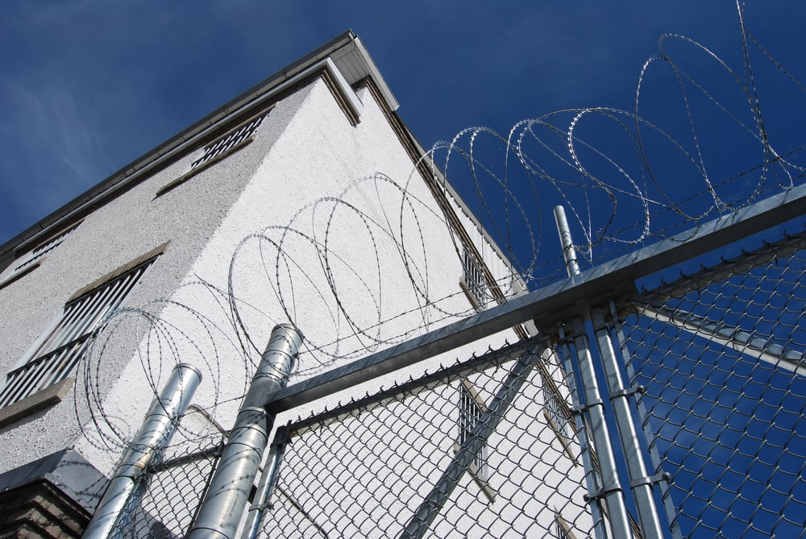
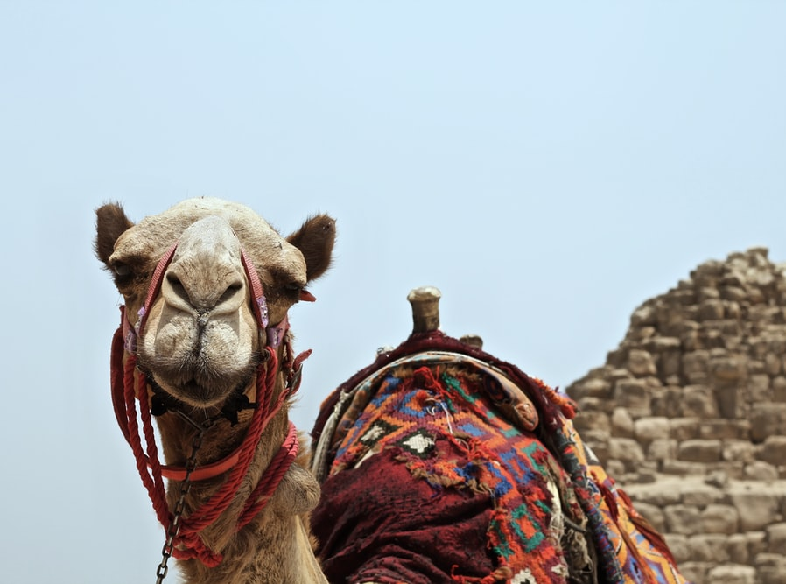
‘Joseph the Dreamer’
META-MORPHOSIS JUVENILE REHABILITATION PROGRAM ™
A young man thrown into prison for 13 years and surfaced Governor of Egypt.
A story of attitude and forgiveness.
Class 7
Notes:
Narration: Bible Study 7

Slide 2
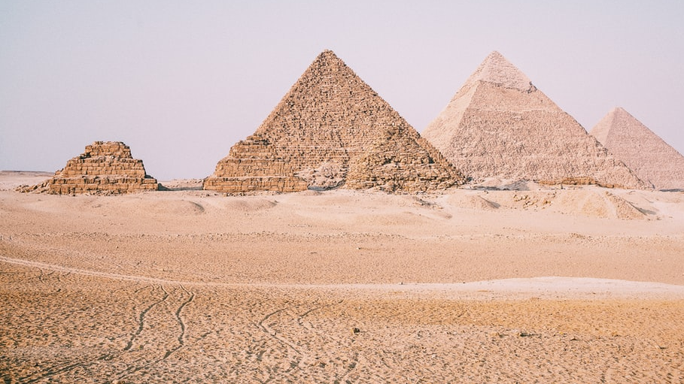
Joseph “From a Dreamer to Governor”
Notes:
Narrative:

Slide 3
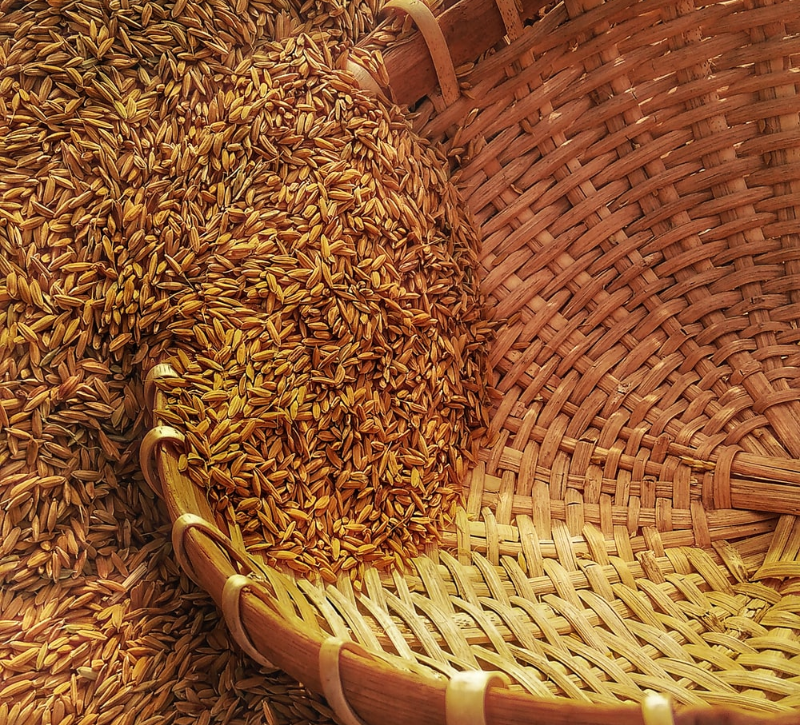
Jacob sends Joseph’s brothers to Egypt to get them grain during the famine
Notes:
Narrative:
Text: Genesis 42 1 -38
Joseph’s Brothers Go to Egypt
When Jacob saw that there was grain in Egypt, Jacob said to his sons, “Why do you look at one another?” And he said, “Indeed I have heard that there is grain in Egypt; go down to that place and buy for us there, that we may live and not die.” So Joseph’s ten brothers went down to buy grain in Egypt. But Jacob did not send Joseph’s brother Benjamin with his brothers, for he said, “Lest some calamity befall him.” And the sons of Israel went to buy grain among those who journeyed, for the famine was in the land of Canaan.

Slide 4
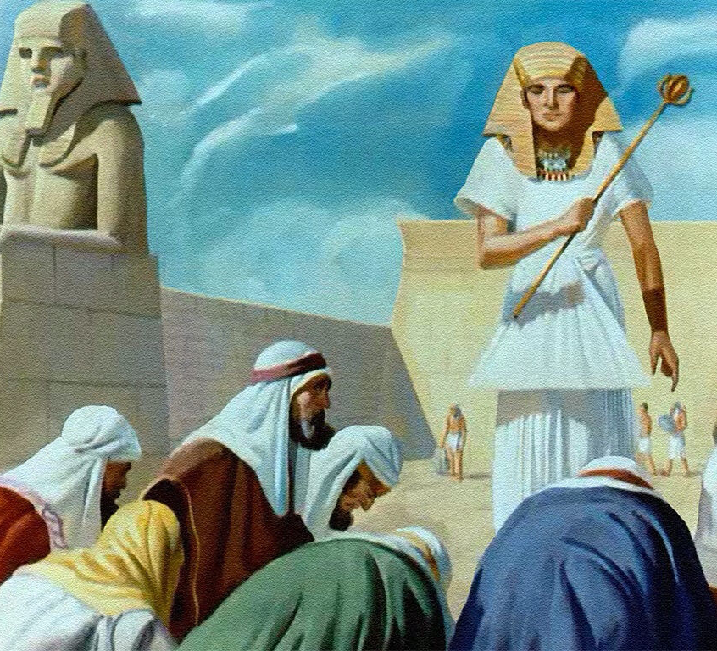
Joseph recognizes his brothers, but they don’t recognize him
Notes:
Narrative:
Now Joseph was governor over the land; and it was he who sold to all the people of the land. And Joseph’s brothers came and bowed down before him with their faces to the earth. Joseph saw his brothers and recognized them, but he acted as a stranger to them and spoke roughly to them. Then he said to them, “Where do you come from?” And they said, “From the land of Canaan to buy food.” So Joseph recognized his brothers, but they did not recognize him.

Slide 5
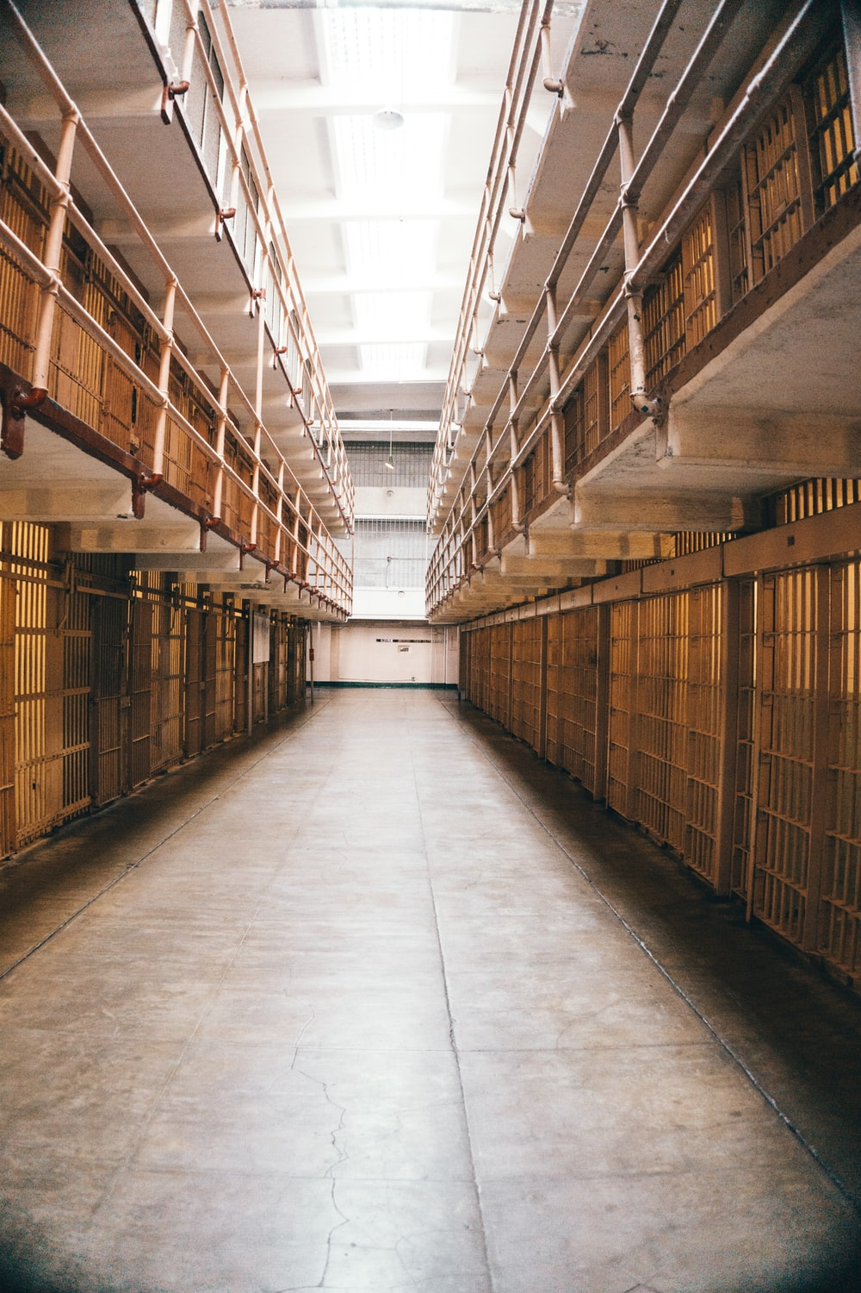
Joseph puts his brothers in prison for 3 days
Notes:
Narrative:
Then Joseph remembered the dreams which he had dreamed about them, and said to them, “You are spies! You have come to see the nakedness of the land!” And they said to him, “No, my lord, but your servants have come to buy food. We are all one man’s sons; we are honest men; your servants are not spies.”
But he said to them, “No, but you have come to see the nakedness of the land.” And they said, “Your servants are twelve brothers, the sons of one man in the land of Canaan; and in fact, the youngest is with our father today, and one is no more.” But Joseph said to them, “It is as I spoke to you saying ‘You are spies!’ In this manner you shall be tested: By the life of Pharaoh, you shall not leave this place unless your youngest brother comes here. Send one of you, and let him bring your brother; and you shall be kept in prison, that your words may be tested to see whether there is any truth in you; or else, by the life of Pharaoh, surely you are spies!” So he put them all together in prison three days.

Slide 6
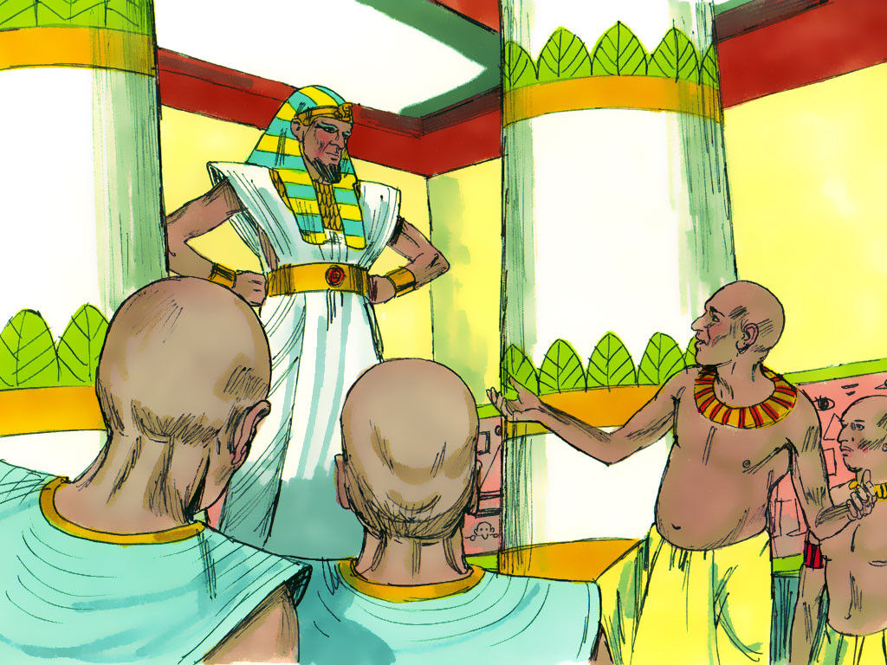
Joseph asks that the brothers bring Benjamin to him
Notes:
Narrative:
Then Joseph said to them the third day, “Do this and live, for I fear God: If you are honest men, let one of your brothers be confined to your prison house; but you, go and carry grain for the famine of your houses. And bring your youngest brother to me; so your words will be verified, and you shall not die.” And they did so. Then they said to one another, “We are truly guilty concerning our\brother, for we saw the anguish of his soul when he pleaded with us, and we would not hear; therefore this distress has come upon us.” And Reuben answered them, saying, “Did I not speak to you, saying, ‘Do not sin against the boy’; and you would not listen? Therefore behold, his blood is now required of us.” But they did not know that Joseph understood them, for he spoke to them through an interpreter. And he turned himself away from them and wept. Then he returned to them again, and talked with them. And he took Simeon from them and bound him before their eyes.

Slide 7
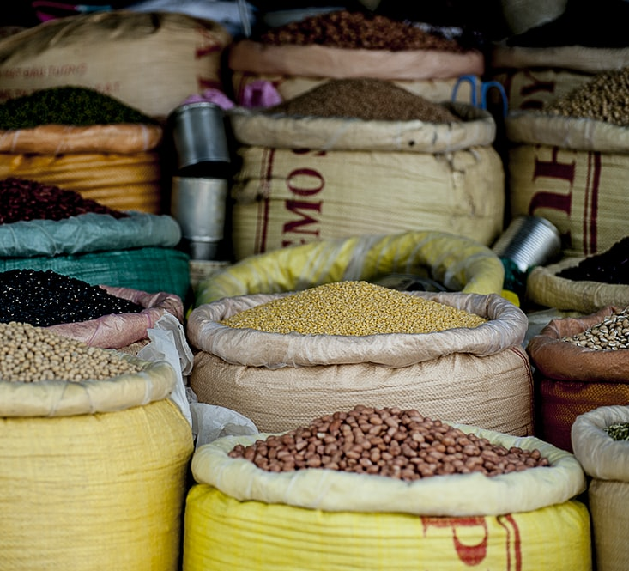
The brothers’ sacks were filled with grain, their restored money, and provisions for the journey
Notes:
Narrative:
Then Joseph gave a command to fill their sacks with grain, to restore every man’s money to his sack, and to give them provisions for the journey. Thus he did for them. So they loaded their donkeys with the grain and departed from there. But as one of them opened his sack to give his donkey feed at the encampment, he saw his money; and there it was, in the mouth of his sack. So he said to his brothers, “My money has been restored, and there it is, in my sack” Then their hearts failed them and they were afraid, saying to one another, “What is this that God has done to us?”

Slide 8
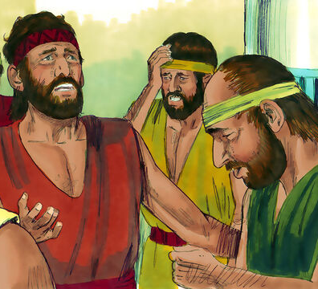
The brothers told Jacob what had happened to them
Notes:
Narrative:
Then they went to Jacob their father in the land of Canaan and told him all that had happened to them, saying: “The man who is lord of the land spoke roughly to us, and took us for spies of the country. But we said to him, ‘We are honest men; we are not spies. We are twelve brothers, sons of our father; one is no more, and the youngest is with our father this day in the land of Canaan.’ Then the man, the lord of the country, said to us, by this I will know that you are honest men: Leave one of your brothers here with me, take food for the famine of your households, and be gone. And bring your youngest brother to me; so I shall know that you are not spies, but that you are honest men. I will grant your brother to you, and you may trade in the land.” Then it happened as they emptied their sacks, that surprisingly each man’s bundle of money was in his sack; and when they and their father saw the bundles of money, they were afraid.

Slide 9
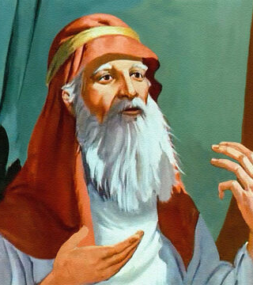
Jacob scolded his sons
Notes:
Narration:
And Jacob their father said to them, “You have bereaved me: Joseph is no more, Simeon is no more, and you want to take Benjamin. All these things are against me.” Then Reuben spoke to his father, saying, “Kill my two sons if I do not bring him back to you; put him in my hands, and I will bring him back to you, but he said, “My son shall not go down with you, for his brother is dead, and he is left alone. If any calamity should befall him along the way in which you go, then you would bring down my gray hair with sorrow to the grave.”

Slide 10
Group Discussion
1. Joseph remembered his dreams of when he was young. What do you think Joseph was thinking when he saw his brothers bow down to him, just like the dream he had so many years ago?
2. How many years ago did he have the dream? (20 years) 37-17=20
3. Joseph put his brothers in prison for three days. Why do you think he did this?
4. Why did he want them to bring his little brother back with them? (Benjamin was his whole brother the rest were half brothers)
5. Why did Joseph cry?
6. Why did he keep one of the brothers with him?
Notes:
Narrative Group Discussion
Break into groups of 4 and discuss the following questions.
Please Note:
Only give them one question at a time, after they have had adequate time to discuss, move to the next question.
Joseph remembered his dreams of when he was young. What do you think Joseph was thinking when he saw his brothers bow down to him, just like the dream he had so many years ago?
How many years ago did he have the dream? (20 years) 37-17=20
Joseph put his brothers in prison for three days. Why do you think he did this?
Why did he want them to bring his little brother back with them? (Benjamin was his whole brother the rest were half brothers)
Why did Joseph cry?
Why did he keep one of the brothers with him?
Why did he put their money back in their sacks?
Was he trying to be vindictive or did he have a plan?
Why didn’t Jacob want his young son Benjamin to go back with them?
Do you think Jacob distrusted his other sons?
Have you ever encountered someone who has hurt you and how did you act toward them?
Which brother stayed in Egypt? (Simeon)
Come back to a whole group and re-ask the same questions and see if anyone wants to share their thoughts.

Slide 11
Group Discussion
7. Why did he put their money back in their sacks?
8. Was he trying to be vindictive or did he have a plan?
9. Why didn’t Jacob want his young son Benjamin to go back with them?
10. Do you think Jacob distrusted his other sons?
11. Have you ever encountered someone who has hurt you and how did you act toward them?
12. Which brother stayed in Egypt? (Simeon)

Slide 12
References
https://images.unsplash.com/photo-1539650116574-8efeb43e2750?ixid=MnwxMjA3fDB8MHxzZWFyY2h8Nnx8ZWd5cHR8ZW58MHx8MHx8&ixlib=rb-1.2.1&auto=format&fit=crop&w=800&q=60
https://images.unsplash.com/photo-1544322230-2804dd91e7bd?ixid=MnwxMjA3fDB8MHxwaG90by1wYWdlfHx8fGVufDB8fHx8&ixlib=rb-1.2.1&auto=format&fit=crop&w=1047&q=80
https://images.unsplash.com/photo-1497563255672-c7240025b733?ixid=MnwxMjA3fDB8MHxzZWFyY2h8MTR8fGVneXB0JTIwZmFtaW5lfGVufDB8fDB8fA%3D%3D&ixlib=rb-1.2.1&auto=format&fit=crop&w=800&q=60
https://images.unsplash.com/photo-1472141521881-95d0e87e2e39?ixid=MnwxMjA3fDB8MHxwaG90by1wYWdlfHx8fGVufDB8fHx8&ixlib=rb-1.2.1&auto=format&fit=crop&w=1052&q=80
https://images.unsplash.com/photo-1536153635972-1fc2e818f642?ixid=MnwxMjA3fDB8MHxzZWFyY2h8MXx8Z3JhaW58ZW58MHx8MHx8&ixlib=rb-1.2.1&auto=format&fit=crop&w=800&q=60
https://images.unsplash.com/photo-1578406696385-30733a350486?ixid=MnwxMjA3fDB8MHxwaG90by1wYWdlfHx8fGVufDB8fHx8&ixlib=rb-1.2.1&auto=format&fit=crop&w=668&q=80
https://media.freebibleimages.org/stories/FB_Moody_Joseph/overview-images/036-moody-joseph.jpg?1613597253
https://media.freebibleimages.org/stories/FB_Joseph_Pharaoh_Dreams/overview-images/002-joseph-pharaoh-dreams.jpg?1613595454
https://media.freebibleimages.org/stories/FB_Joseph_Brothers_1/overview-thumbnails/007-joseph-brothers-1.jpg?1613595462
https://media.freebibleimages.org/stories/FB_Moody_Joseph/overview-thumbnails/016-moody-joseph.jpg?1613597255

Slide 13
Original Narrative
Notes:
JOSEPH
“FROM A DREAMER TO GOVENOR”
Text: Genesis 42 1 -38
Joseph’s Brothers Go to Egypt
When Jacob saw that there was grain in Egypt, Jacob said to his sons, “Why do you look at one another?” And he said, “Indeed I have heard that there is grain in Egypt; go down to that place and buy for us there, that we may live and not die.” So Joseph’s ten brothers went down to buy grain in Egypt. But Jacob did not send Joseph’s brother Benjamin with his brothers, for he said, “Lest some calamity befall him.” And the sons of Israel went to buy grain among those who journeyed, for the famine was in the land of Canaan.
Now Joseph was governor over the land; and it was he who sold to all the people of the land. And Joseph’s brothers came and bowed down before him with their faces to the earth. Joseph saw his brothers and recognized them, but he acted as a stranger to them and spoke roughly to them. Then he said to them, “Where do you come from?” And they said, “From the land of Canaan to buy food.” So Joseph recognized his brothers, but they did not recognize him.
Then Joseph remembered the dreams which he had dreamed about them, and said to them, “You are spies! You have come to see the nakedness of the land!” And they said to him, “No, my lord, but your servants have come to buy food. We are all one man’s sons; we are honest men; your servants are not spies.”
But he said to them, “No, but you have come to see the nakedness of the land.” And they said, “Your servants are twelve brothers, the sons of one man in the land of Canaan; and in fact, the youngest is with our father today, and one is no more.” But Joseph said to them, “It is as I spoke to you saying ‘You are spies!’ In this manner you shall be tested: By the life of Pharaoh, you shall not leave this place unless your youngest brother comes here. Send one of you, and let him bring your brother; and you shall be kept in prison, that your words may be tested to see whether there is any truth in you; or else, by the life of Pharaoh, surely you are spies!” So he put them all together in prison three days.
Then Joseph said to them the third day, “Do this and live, for I fear God: If you are honest men, let one of your brothers be confined to your prison house; but you, go and carry grain for the famine of your houses. And bring your youngest brother to me; so your words will be verified, and you shall not die.” And they did so. Then they said to one another, “We are truly guilty concerning our\brother, for we saw the anguish of his soul when he pleaded with us, and we would not hear; therefore this distress has come upon us.” And Reuben answered them, saying, “Did I not speak to you, saying, ‘Do not sin against the boy’; and you would not listen? Therefore behold, his blood is now required of us.” But they did not know that Joseph understood them, for he spoke to them through an interpreter. And he turned himself away from them and wept. Then he returned to them again, and talked with them. And he took Simeon from them and bound him before their eyes.
The Brothers Return to Canaan
Then Joseph gave a command to fill their sacks with grain, to restore every man’s money to his sack, and to give them provisions for the journey. Thus he did for them. So they loaded their donkeys with the grain and departed from there. But as one of them opened his sack to give his donkey feed at the encampment, he saw his money; and there it was, in the mouth of his sack. So he said to his brothers, “My money has been restored, and there it is, in my sack” Then their hearts failed them and they were afraid, saying to one another, “What is this that God has done to us?” Then they went to Jacob their father in the land of Canaan and told him all that had happened to them, saying: “The man who is lord of the land spoke roughly to us, and took us for spies of the country. But we said to him, ‘We are honest men; we are not spies. We are twelve brothers, sons of our father; one is no more, and the youngest is with our father this day in the land of Canaan.’ Then the man, the lord of the country, said to us, by this I will know that you are honest men: Leave one of your brothers here with me, take food for the famine of your households, and be gone. And bring your youngest brother to me; so I shall know that you are not spies, but that you are honest men. I will grant your brother to you, and you may trade in the land.” Then it happened as they emptied their sacks, that surprisingly each man’s bundle of money was in his sack; and when they and their father saw the bundles of money, they were afraid.
And Jacob their father said to them, “You have bereaved me: Joseph is no more, Simeon is no more, and you want to take Benjamin. All these things are against me.” Then Reuben spoke to his father, saying, “Kill my two sons if I do not bring him back to you; put him in my hands, and I will bring him back to you, but he said, “My son shall not go down with you, for his brother is dead, and he is left alone. If any calamity should befall him along the way in which you go, then you would bring down my gray hair with sorrow to the grave.”
Meta-Morphosis5 5/17/08
A commitment and vision for the future through peremptory development of youth Cheryl K Langford
Study Group Questions
Joseph remembered his dreams of when he was young. What do you think Joseph was thinking when he saw his brothers bow down to him, just like the dream he had so many years ago?
How many years ago did he have the dream? (20 years) 37-17=20
Joseph put his brothers in prison for three days. Why do you think he did this?
Why did he want them to bring his little brother back with them? (Benjamin was his whole brother the rest were half brothers)
Why did Joseph cry?
Why did he keep one of the brothers with him?
Why did he put their money back in their sacks?
Was he trying to be vindictive or did he have a plan?
Why didn’t Jacob want his young son Benjamin to go back with them?
Do you think Jacob distrusted his other sons?
Have you ever encountered someone who has hurt you and how did you act toward them?
Which brother stayed in Egypt? (Simeon)

