Slide 1
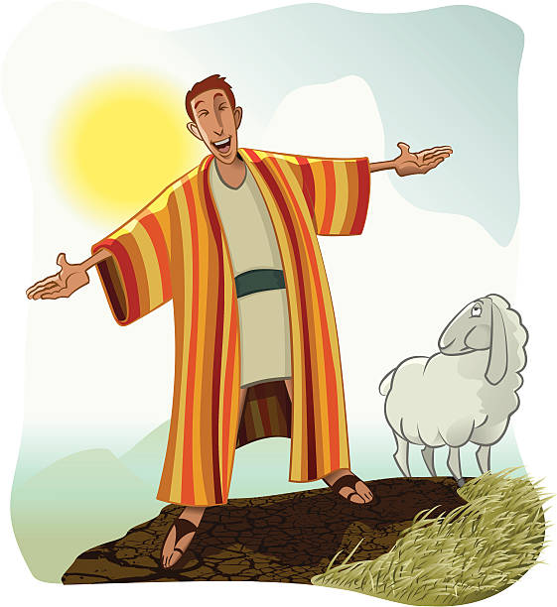
‘Joseph the Dreamer’
META-MORPHOSIS JUVENILE REHABILITATION PROGRAM ™
A young man thrown into prison for 13 years and surfaced Governor of Egypt.
A story of attitude and forgiveness.
Class 3
Notes:
Narration: Bible Study 3

Slide 2
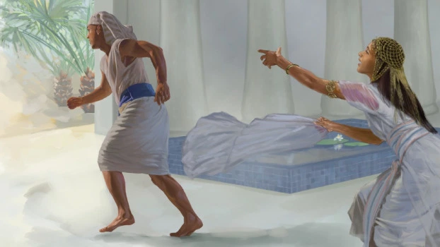
Joseph is tempted to sin
Notes:
Narrative

Slide 3
Potiphar saw the Lord was with Joseph
Notes:
Narrative:
Text Genesis 39: 1-23
Joseph is tempted to sin
And Joseph was brought down to Egypt and Potiphar, an officer in Pharaoh’s army, captain of the guard, an Egyptian, bought him of the hand of the Ishmaelite’s, which had brought him down.
And the Lord was with Joseph, and he was a prosperous man, and he was in the house of his master the Egyptian.
And Potiphar saw that the Lord was with the man, and that the Lord made all that he did to prosper in his hands.

Slide 4
Potiphar greatly trusted Joseph, putting him in charge of most everything
Notes:
Narrative:
And Joseph found grace in his sight, and he served him and he made him overseer over all of his house and all that he put into his hand.
And the Lord blessed the Egyptians house for Joseph’s sake, and the blessing of the Lord was upon all that he had in the house, and in the field.
And he left Joseph in charge of everything, and he didn’t even what he had or didn’t have, he trusted Joseph so much. And Joseph was a goodly person and well favoured.

Slide 5
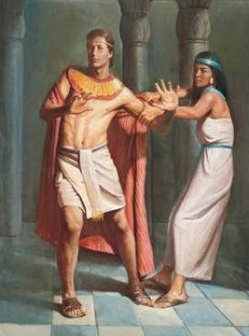
Potiphar’s wife tries to cheat on Potiphar with Joseph
Notes:
Narrative:
And it came to pass that after a while that his master’s wife cast her eyes upon Joseph, and said come and lie with me.
But he refused and said unto his master’s wife, Behold my master has commited all that he has in his house to me.
There is none greater in this house than I. neither has he held anything back from me, except you, because you are his wife, then how can I do such wickedness and sin against God.
And it came to pass, as she spoke to Joseph day by day, that he harkened not unto her , to lie with her, or to be with her.
And it came to pass as Joseph went into the house to do his work, and there was no one in the house except Joseph and Potiphars wife. And she caught him by his garment saying come lie with me, and he ran and left his garment in her hands and he fled the house.

Slide 6
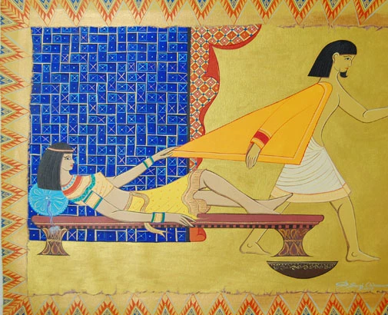
Potiphar’s wife frames Joseph
Notes:
Narrative
And it came to pass as she saw that he had left his garment in her hand that she called unto the men of the house saying, see, he hath brought in a Hebrew to mock mem he came in to try and lie with me, and I cries with a loud voice. And it came to pass that when he heard me screaming that he left his garment with me and fled and ran out of the house.
And she took his garment and waited for her husband to come home.
And she spoke unto him according to these words, The Hebrew servant that you brought into this house has mocked me and tried to lie with me and I screamed and he ran and left his garment with me.
And it came to pass, when his master heard the words of his wife that his anger was kindled. He was furious.

Slide 7
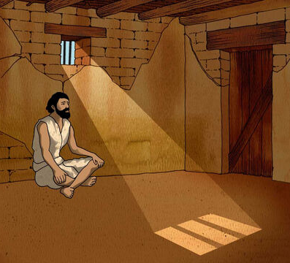
Joseph is thrown back into prison
Notes:
Narrative:
And Joseph’s master took him, and out him in into the prison, a place where the King’s prisoners were bound and he was in prison.
But the Lord was with Joseph and showed him mercy, and gave him favor in the sight of the keeper of the prison.
And the keeper of the prison committed all that was in his hands to Joseph. And whatever was done there Joseph was the doer of it.
The keeper of the prison looked not unto anything that was under his hand and whatever Joseph did it was made to prosper.

Slide 8
Group Discussion
1. How do you think Potiphar knew that God was with Joseph?
2. What kind of person do you think Joseph was, for him to feel that way?
3. Joseph could have acted differently, after all he was mistreated badly and he was innocent and sold into slavery by his own family.
4. Joseph was all alone, no family, why didn’t he sleep with his Master’s wife, after all he could have said “I deserve some comfort in this valley of tears?
5. Why do you think that the Lord was with Joseph ?
6. Why is attitude so important?
Notes:
Narrative Group Discussion
Break into groups of 4 and discuss the following questions.
Please Note:
Only give them one question at a time, after they have had adequate time to discuss, move to the next question.
How do you think Potiphar knew that God was with Joseph?
What kind of person do you think Joseph was, for him to feel that way?
Joseph could have acted differently, after all he was mistreated badly and he was innocent and sold into slavery by his own family.
Joseph was all alone, no family, why didn’t he sleep with his Master’s wife, after all he could have said “I deserve some comfort in this valley of tears?
Why do you think that the Lord was with Joseph ?
Why is attitude so important?
Joseph was put in charge of everything in the prison. He could of taken two approaches to this situation. He could have said “I’m not doing all this extra work” or he could have said “This responsibility is not mine”
Do you think Joseph would have had favor with everyone if he had a bad attitude?
What is your attitude, Is it like Josephs?
Have you been tempted to do things that are not right in here?
Come back to a whole group and re-ask the same questions and see if anyone wants to share their thoughts.

Slide 9
Group Discussion
7. Joseph was put in charge of everything in the prison. He could of taken two approaches to this situation. He could have said “I’m not doing all this extra work” or he could have said “This responsibility is not mine”
8. Do you think Joseph would have had favor with everyone if he had a bad attitude?
9. What is your attitude, Is it like Josephs?
10. Have you been tempted to do things that are not right in here?

Slide 10
References
https://dailydosewithdrshermaine.files.wordpress.com/2019/09/dose31.jpg?w=700&h=350
https://media.freebibleimages.org/stories/FB_Joseph_Prison/overview-images/003-joseph-prison.jpg?1613595448
https://assets.ldscdn.org/c0/6e/c06e7e4578522af9f240d216b0742985b82bfee41060577/joseph_egypt_interprets_dreams_parson.jpeg
https://i.pinimg.com/originals/91/51/60/91516065c8175a44f662c436029a729e.jpg
https://regehrlein.files.wordpress.com/2016/01/joseph-potiphar.jpg?w=640
https://media.freebibleimages.org/stories/FB_YO_Joseph_Prison/overview-thumbnails/004-yo-joseph-prison.jpg?1613597974
https://thumbs.dreamstime.com/b/prison-jail-criminal-convict-prisoner-cell-outside-his-doing-hard-time-sad-to-be-behind-bars-127256735.jpg
https://media.istockphoto.com/vectors/josephs-coat-of-many-colors-vector-id140083911?b=1&k=6&m=140083911&s=612x612&w=0&h=iVrJ45HCZVAW8qQpPmBe7-Tst5J09W_0hHIMTs4tlAA=

Slide 11
Original Narrative
Notes:
JOSEPH
“FROM A DREAMER TO GOVENOR”
Text Genesis 39: 1-23
Joseph is tempted to sin
And Joseph was brought down to Egypt and Potiphar, an officer in Pharaoh’s army, captain of the guard, an Egyptian, bought him of the hand of the Ishmaelite’s, which had brought him down.
And the Lord was with Joseph, and he was a prosperous man, and he was in the house of his master the Egyptian.
And Potiphar saw that the Lord was with the man, and that the Lord made all that he did to prosper in his hands.
And Joseph found grace in his sight, and he served him and he made him overseer over all of his house and all that he put into his hand.
And the Lord blessed the Egyptians house for Joseph’s sake, and the blessing of the Lord was upon all that he had in the house, and in the field.
And he left Joseph in charge of everything, and he didn’t even what he had or didn’t have, he trusted Joseph so much. And Joseph was a goodly person and well favoured.
And it came to pass that after a while that his master’s wife cast her eyes upon Joseph, and said come and lie with me.
But he refused and said unto his master’s wife, Behold my master has commited all that he has in his house to me.
There is none greater in this house than I. neither has he held anything back from me, except you, because you are his wife, then how can I do such wickedness and sin against God.
And it came to pass, as she spoke to Joseph day by day, that he harkened not unto her , to lie with her, or to be with her.
And it came to pass as Joseph went into the house to do his work, and there was no one in the house except Joseph and Potiphars wife. And she caught him by his garment saying come lie with me, and he ran and left his garment in her hands and he fled the house.
And it came to pass as she saw that he had left his garment in her hand that she called unto the men of the house saying, see, he hath brought in a Hebrew to mock mem he came in to try and lie with me, and I cries with a loud voice. And it came to pass that when he heard me screaming that he left his garment with me and fled and ran out of the house.
And she took his garment and waited for her husband to come home.
And she spoke unto him according to these words, The Hebrew servant that you brought into this house has mocked me and tried to lie with me and I screamed and he ran and left his garment with me.
And it came to pass, when his master heard the words of his wife that his anger was kindled. He was furious.
And Joseph’s master took him, and out him in into the prison, a place where the King’s prisoners were bound and he was in prison.
But the Lord was with Joseph and showed him mercy, and gave him favor in the sight of the keeper of the prison.
And the keeper of the prison committed all that was in his hands to Joseph. And whatever was done there Joseph was the doer of it.
The keeper of the prison looked not unto anything that was under his hand and whatever Joseph did it was made to prosper.
Meta-Morphosis5 5/17/08
A commitment and vision for the future through peremptory development of youth Cheryl K Langford
STUDY GROUP QUESTIONS
How do you think Potiphar knew that God was with Joseph?
What kind of person do you think Joseph was, for him to feel that way?
Joseph could have acted differently, after all he was mistreated badly and he was innocent and sold into slavery by his own family.
Joseph was all alone, no family, why didn’t he sleep with his Master’s wife, after all he could have said “I deserve some comfort in this valley of tears?
Why do you think that the Lord was with Joseph ?
Why is attitude so important?
Joseph was put in charge of everything in the prison. He could of taken two approaches to this situation. He could have said “I’m not doing all this extra work” or he could have said “This responsibility is not mine”
Do you think Joseph would have had favor with everyone if he had a bad attitude?
What is your attitude, Is it like Josephs?
Have you been tempted to do things that are not right in here?

