Slide 1
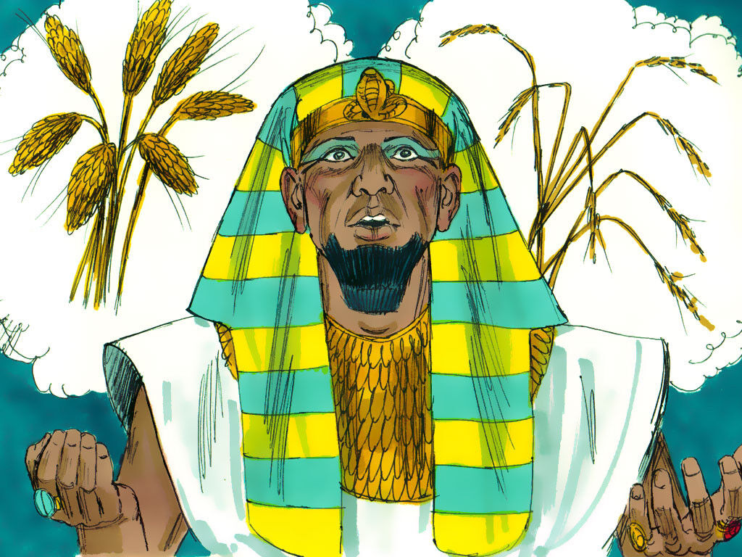
‘Joseph the Dreamer’
META-MORPHOSIS JUVENILE REHABILITATION PROGRAM ™
A young man thrown into prison for 13 years and surfaced Governor of Egypt.
A story of attitude and forgiveness.
Class 2
Notes:
Bible Study 2nd class

Slide 2
Joseph Searches for his Brothers
Notes:
Narrative:
Text Genesis 37: 12-36
Joseph sold to merchants
And his brethren went to feed his father’s flock in Shechem. And Israel said to Joseph, Your brothers are feeding the flock, come and I will send thee unto them. And he said, Here I am.
And he said to him, go I pray and see whether they are all right and that everything is well with the flocks and bring me word again about these things. So he sent them out to the vale of Hebron and he came to Shechem.
And a certain man found him and behold he was wandering in the field and the man asked him, what are you looking for?
And he said to him, I am looking for my brothers, tell me please where are they and where are they feeding the flocks.
And the man said they are gone for I heard them say, Let us go to Dothan. And Joseph went after his brothers, and found them in Dothan.

Slide 3
Joseph’s Brothers Conspire Against Him
Notes:
Narrative
And when his brothers saw them from afar off, before he got to them, they conspired to slay him.
And they said to one another, here comes the dreamer.
Come now and let us slay him, and cast him into the pit, and we will say, that some evil beast hath devoured him. Then we will see what will become of his dreams.
And Rueben, one of his brothers heard it and said unto them, Let us not Kill him. And Rueben said unto them, shed no blood but cast him into the pit that is in the wilderness, and lay no hand on him. He thought he could save him and return him to his father, and he might rid him out of their hand. And it came to pass, when Joseph came to his brothers, that they stripped Joseph out of his coat, the coat of many colors that he was wearing.
And they took him, and cast him into a pit, and the pit was empty, there was no water in it.

Slide 4
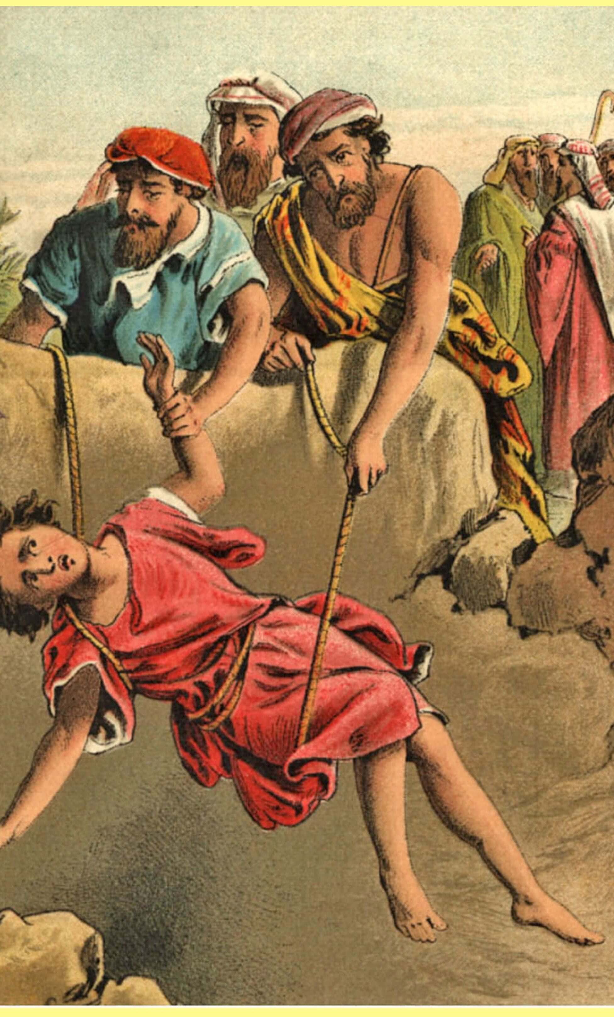
Joseph’s Brothers Sell Him to Ishmaelites
Notes:
Narrative
And they sat down to eat bread, and they lifted their eyes up and looked, and behold, a company of Ishmaelite’s who were coming from Gilead with their camels bearing spices and balm and myrrh, were going down to Egypt.
And Judah said to his brothers, what profit is it if we slay our brother and conceal his blood, come let us sell him to the Ishmaelite’s and let not our hand be upon him, for he is our brother and our flesh. And his brothers agreed with Judah, and were content.
Then they passed by Midianites merchantmen, and they lifted Joseph up out of the pit, and sold Joseph their brother to the Ishmaelite’s for twenty pieces of silver and they brought Joseph down into Egypt.

Slide 5
Joseph’s Brothers Fake his Death
Notes:
Narrative:
And when Rueben returned to the pit and Joseph was gone he tore his clothes and cried out.
And he returned to his brothers and said the child is gone, and what do I do now…
And they took Joseph’s coat of many colors, and they brought it to their father, and said we found this coat see whether it is Joseph’s or not?
And he said , It is my son’s coat, an evil beast has devoured him and Joseph is in no doubt rent in pieces.
And Jacob tore his clothes and put sackcloth upon his loins, and mourned. Then his father wept for him.

Slide 6
Joseph is Sold to Potiphar
Notes:
Narrative:
And the Midianites sold him into Egypt to a man named Potiphar, who was an officer in the Army of Pharaoh and was captain of the guard.

Slide 7
Group Discussion
1. Why do you think they wanted to kill Joseph?
2. Do you know a family where there are many brothers or sisters?
3. Do they get along or is one brother or more singled out and hated?
4. When a loved one dies there is much grief, how would you handle the situation if you were Jacob the father?
5. Would you feel guilty about selling your little brother?
Notes:
Narrative Group Discussion
Break into groups of 4 and discuss the following questions.
Please Note:
Only give them one question at a time, after they have had adequate time to discuss, move to the next question.
STUDY GROUP QUESTIONS
Why do you think they wanted to kill Joseph?
Do you know a family where there are many brothers or sisters?
Do they get along or is one brother or more singled out and hated?
When a loved one dies there is much grief, how would you handle the situation if you were Jacob the father?
Would you feel guilty about selling your little brother?
Do you want to save you younger siblings from getting into trouble?
How would you do that if you could? What would you do?
Everywhere you look there are laws, and you know the consequences of breaking them, what will you do in the future so you don’t waste your life in places like these?
After they sold Joseph to the Midianites, what was the very next thing they did? (ate!)
How could they do that?
Come back to a whole group and re-ask the same questions and see if anyone wants to share their thoughts.

Slide 8
Group Discussion
6. Do you want to save you younger siblings from getting into trouble?
7. How would you do that if you could? What would you do?
8. Everywhere you look there are laws, and you know the consequences of breaking them, what will you do in the future so you don’t waste your life in places like these?
9. After they sold Joseph to the Midianites, what was the very next thing they did? (ate!)
10. How could they do that?

Slide 9
References
https://images.reference.com/amg-cms-reference-images/media/group-sheep-called_9563a42eb1f5c4ec.jpg?fit=crop&width=900&height=900
https://scripturelady.com/wp-content/uploads/2018/08/Joseph-Pic-Thrown-Into-the-Well.jpeg
https://images.squarespace-cdn.com/content/v1/575ee612cf80a17326a41248/1476760898732-3ZYXVKO7ISR75Z9Z0Q24/ke17ZwdGBToddI8pDm48kDg3tTBllHO0I6vPpG3XTKtZw-zPPgdn4jUwVcJE1ZvWEtT5uBSRWt4vQZAgTJucoTqqXjS3CfNDSuuf31e0tVEUKDR0tE5RUUxn5oHGbd_sdHGBooQWM4Lp4ziy4Q5jgefjWhQI09m6m2Dqi11SWuQ/Picture1.jpg
https://ldsseminary.files.wordpress.com/2017/09/joseph.jpg?resize=400%2C265
https://p8.secure.hostingprod.com/@www.martin2001.com/ssl/Blutige-bock-josephs-coypel-BIBEL-1887-.jpg
https://static.wikia.nocookie.net/totalwar-ar/images/c/c4/Potiphar.jpg/revision/latest?cb=20190508050324
https://media.istockphoto.com/photos/jail-cell-picture-id502846348?k=6&m=502846348&s=612x612&w=0&h=rhL5-ze1NqTp7DK7oUqzrOlxI-okK19X76GCm_0OkeA=
https://media.freebibleimages.org/stories/FB_Joseph_Pharaoh_Dreams/overview-images/006-joseph-pharaoh-dreams.jpg?1613595454

Slide 10
Original Narrative
Notes:
Narrative:
JOSEPH
“FROM A PRISONER TO GOVERNOR”
Text Genesis 37: 12-36
Joseph sold to merchants
And his brethren went to feed his father’s flock in Shechem. And Israel said to Joseph, Your brothers are feeding the flock, come and I will send thee unto them. And he said, Here I am.
And he said to him, go I pray and see whether they are all right and that everything is well with the flocks and bring me word again about these things. So he sent them out to the vale of Hebron and he came to Shechem.
And a certain man found him and behold he was wandering in the field and the man asked him, what are you looking for?
And he said to him, I am looking for my brothers, tell me please where are they and where are they feeding the flocks.
And the man said they are gone for I heard them say, Let us go to Dothan. And Joseph went after his brothers, and found them in Dothan.
And when his brothers saw them from afar off, before he got to them, they conspired to slay him.
And they said to one another, here comes the dreamer.
Come now and let us slay him, and cast him into the pit, and we will say, that some evil beast hath devoured him. Then we will see what will become of his dreams.
And Rueben, one of his brothers heard it and said unto them, Let us not Kill him. And Rueben said unto them, shed no blood but cast him into the pit that is in the wilderness, and lay no hand on him. He thought he could save him and return him to his father, and he might rid him out of their hand.
And it came to pass, when Joseph came to his brothers, that they stripped Joseph out of his coat, the coat of many colors that he was wearing.
And they took him, and cast him into a pit, and the pit was empty, there was no water in it.
And they sat down to eat bread, and they lifted their eyes up and looked, and behold, a company of Ishmaelite’s who were coming from Gilead with their camels bearing spices and balm and myrrh, were going down to Egypt.
And Judah said to his brothers, what profit is it if we slay our brother and conceal his blood, come let us sell him to the Ishmaelite’s and let not our hand be upon him, for he is our brother and our flesh. And his brothers agreed with Judah, and were content.
Then they passed by Midianites merchantmen, and they lifted Joseph up out of the pit, and sold Joseph their brother to the Ishmaelite’s for twenty pieces of silver and they brought Joseph down into Egypt.
And when Rueben returned to the pit and Joseph was gone he tore his clothes and cried out.
And he returned to his brothers and said the child is gone, and what do I do now…
And they took Joseph’s coat of many colors, and they brought it to their father, and said we found this coat see whether it is Joseph’s or not?
And he said , It is my son’s coat, an evil beast has devoured him and Joseph is in no doubt rent in pieces.
And Jacob tore his clothes and put sackcloth upon his loins, and mourned. Then his father wept for him.
And the Midianites sold him into Egypt to a man named Potiphar, who was an officer in the Army of Pharaoh and was captain of the guard.
Meta-Morphosis 5/17/08
A commitment and vision for the future through peremptory development of youth Cheryl K Langford
STUDY GROUP QUESTIONS
Why do you think they wanted to kill Joseph?
Do you know a family where there are many brothers or sisters?
Do they get along or is one brother or more singled out and hated?
When a loved one dies there is much grief, how would you handle the situation if you were Jacob the father?
Would you feel guilty about selling your little brother?
Do you want to save you younger siblings from getting into trouble?
How would you do that if you could? What would you do?
Everywhere you look there are laws, and you know the consequences of breaking them, what will you do in the future so you don’t waste your life in places like these?
After they sold Joseph to the Midianites, what was the very next thing they did? (ate!)
How could they do that?

