Slide 1
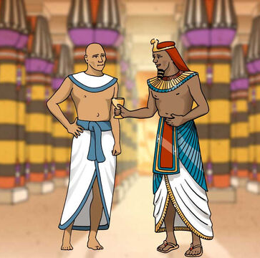
‘Joseph the Dreamer’
META-MORPHOSIS JUVENILE REHABILITATION PROGRAM ™
A young man thrown into prison for 13 years and surfaced Governor of Egypt.
A story of attitude and forgiveness.
Class 11
Notes:
Narration: Bible Study 11
? Is there an evil force behind all of the negative actions on our planet
What will happen to me after I die?
Am I all alone?
These are questions on all of our minds at some time or another. There are those that believe in creationism versus evolutionism? The answers to all of these questions are in the Bible.

Slide 2
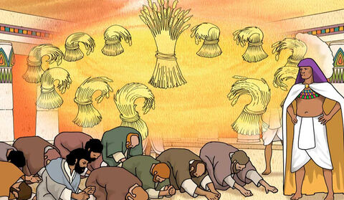
Joseph “From a Dreamer to Governor”
Notes:
Narrative:

Slide 3
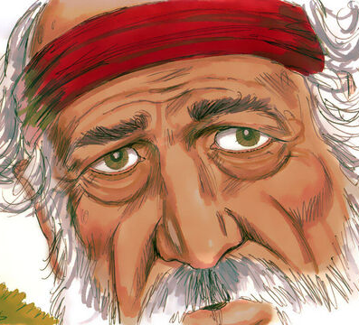
God speaks to Jacob in visions telling him not to fear going to Egypt
Notes:
Narrative:
TEXT: Genesis 46 1- 7 and 28-34
Joseph and his father are reunited
Israel took his journey with all that he had, and came to Beersheba, and offered sacrifices to the God of his father Isaac. 2 Then God spoke to visions of the “Jacob, Jacob!” and he said, “Here I am.”
So He said, “I am God, the God of your father; do not fear to go down to Egypt, for I will make of you a great nation there. I will go down with you to Egypt, and I will also surely bring you up again; and Joseph will put his hand on your eyes.” Then Jacob arose from Beersheba; and the sons of Israel carried their father Jacob, their little ones, and their wives, in the carts, which Pharaoh had sent to carry him. So, they took their livestock and their goods, which they had acquired in the land of Canaan, and went to Egypt, Jacob and all his descendants with him. His sons and his daughters and his sons’ daughters, and all his descendants he brought with him to Egypt.

Slide 4
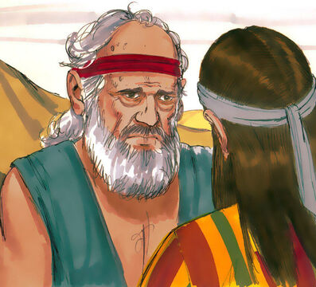
Joseph went up to Goshen to see his father
Notes:
Narrative:
Then he sent Judah before him to Joseph, to point out before him the way to Goshen, and they came to the land of Goshen. So Joseph made ready his chariot and went up to Goshen to meet his father Israel; and he presented himself to him, and fell on his neck and wept on his neck a good while.

Slide 5
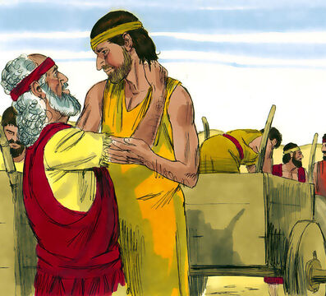
Jacob feels he can die now that he has seen his son once again
Notes:
Narrative:
Israel said to Joseph, “Now let me die, since I have seen your face, because you are still alive.”

Slide 6
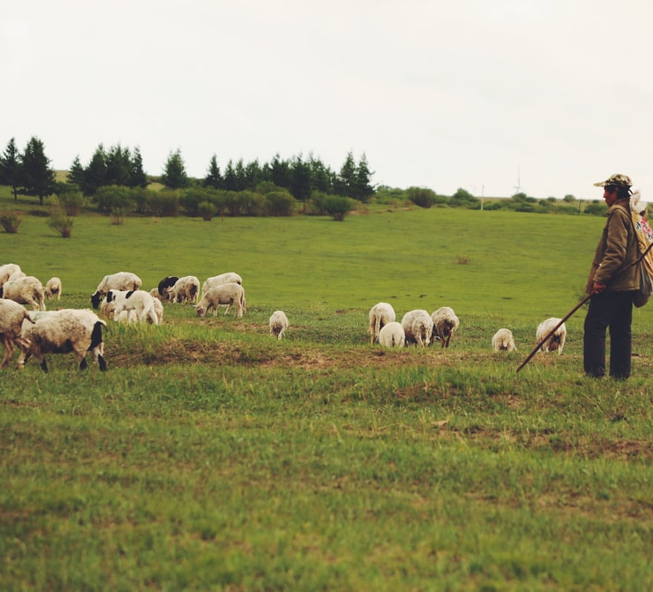
Joseph tells his brothers to make it known that they are shepherds
Notes:
Narrative:
Then Joseph said to his brothers and to his father’s household, “I will go up and tell Pharaoh, and say to him, ‘My brothers and those of my father’s house, who were in the land of Canaan, have come to me. And the men are shepherds, for their occupation has been to feed livestock; and they have brought their flocks, their herds, and all that they have.’ So it shall be, when Pharaoh calls you and says, ‘What is your occupation?’ that you shall say, ‘Your servants’ occupation has been with livestock from our youth even till now, both we and also our fathers,’ that you may dwell in the land of Goshen; for every shepherd Is an abomination to the Egyptians.”
Text: Genesis 47 1-12
Then Joseph went and told Pharaoh, and said, “My father and my brothers, their flocks and their herds and all that they possess, have come from the land of Canaan; and indeed they are in the land of Goshen.” and he took five men from among his brothers and presented them to Pharaoh. Then Pharaoh said to his brothers, “What is your occupation?” and they said to Pharaoh, “Your servants are shepherds, both we and also our fathers.” and they said to Pharaoh, “We have come to dwell in the land, because your servants have no pasture for their flocks, for the famine is severe in the land of Canaan. Now therefore, please let your servants dwell in the land of Goshen.”

Slide 7
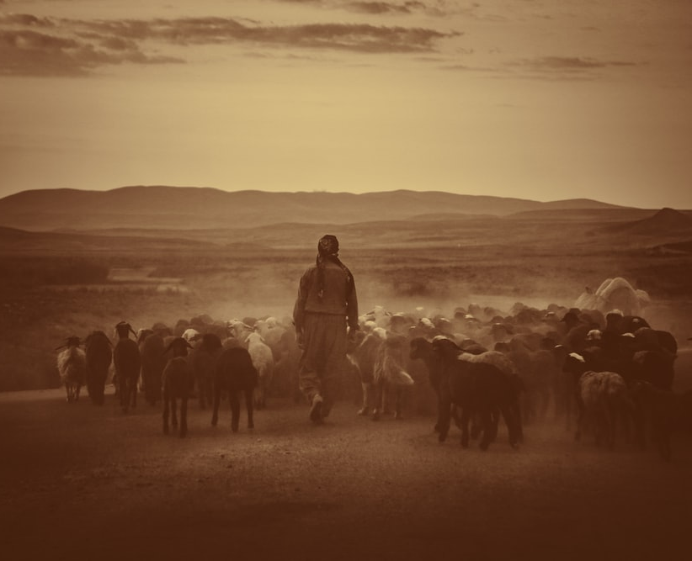
Pharaoh makes Joseph’s brothers chief herdsmen over his livestock
Notes:
Narrative:
Then Pharaoh spoke to Joseph, saying, “Your father and your brothers have come to you. The land of Egypt is before you and in the best of the land make your father and brothers to dwell in the best of the land; let them dwell in the land of Goshen. And if you know any competent men among them, then make them chief herdsmen over my livestock.”

Slide 8
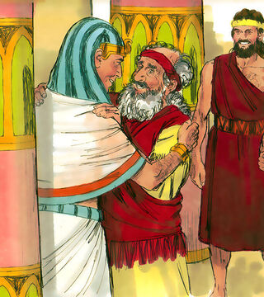
Jacob blessed Pharaoh and Jacob’s family was provided with everything they should need
Notes:
Narrative:
.” Then Joseph brought in his father Jacob and set him before Pharaoh; and Jacob blessed Pharaoh. Pharaoh said to Jacob, “How old are you?” and Jacob said to Pharaoh, “The days of the years of my pilgrimage are one hundred and thirty years; few and evil have been the days of the years of my life, and they have not attained to the days of the years of the life of my fathers in the days of their pilgrimage.” Jacob blessed Pharaoh, and went out from before Pharaoh, and Joseph situated his father and his brothers, and gave them a possession in the land of Egypt, in the best of the land, in the land of Ramses, as Pharaoh had commanded. Then Joseph provided his father, his brothers, and all his father’s household with bread, according to the number in their families.

Slide 9
Group Discussion
1. What did you learn from this true story?
2. Do you feel attitude and forgiveness is important and why?
3. Can you rewrite this story with Joseph having a bad attitude? Try
4. How do you think it would read?
5. What options do you have for your life?
Notes:
Narrative Group Discussion
Break into groups of 4 and discuss the following questions.
Please Note:
Only give them one question at a time, after they have had adequate time to discuss, move to the next question.
1. What did you learn from this true story?
2. Do you feel attitude is important and why?
3. Can you rewrite this story with Joseph having a bad attitude? Try
4. How do you think it would read?
5. What options do you have for your life?
6. Do you think God is really watching?
7. Is there any one you need to forgive?
8. Is there someone you would like to reunite with?
9. Do you think your attitude should change?
10. What area?
* Teacher will lead them in a forgiveness prayer.
Come back to a whole group and re-ask the same questions and see if anyone wants to share their thoughts.

Slide 10
Group Discussion
6. Do you think God is really watching?
7. Is there any one you need to forgive?
8. Is there someone you would like to reunite with?
9. Do you think your attitude should change?
10. What area?

Slide 11
References
https://images.unsplash.com/photo-1613354774295-7f32454c45e5?ixid=MnwxMjA3fDB8MHxwaG90by1wYWdlfHx8fGVufDB8fHx8&ixlib=rb-1.2.1&auto=format&fit=crop&w=668&q=80
https://media.freebibleimages.org/stories/FB_YO_Joseph_Prison/overview-thumbnails/015-yo-joseph-prison.jpg?1613597975
https://media.freebibleimages.org/stories/FB_YO_Joseph_Brothers/overview-thumbnails/003-yo-joseph-brothers.jpg?1613597999
https://media.freebibleimages.org/stories/FB_Joseph_Dreams/overview-thumbnails/008-joseph-dreams.jpg?1613595444
https://media.freebibleimages.org/stories/FB_Joseph_Dreams/overview-thumbnails/007-joseph-dreams.jpg?1613595443
https://media.freebibleimages.org/stories/FB_Joseph_Reunion/overview-thumbnails/001-joseph-reunion.jpg?1613595465
https://images.unsplash.com/photo-1599561252054-8160d7fe37d6?ixid=MnwxMjA3fDB8MHxzZWFyY2h8MXx8c2hlcGhlcmRzfGVufDB8fDB8fA%3D%3D&ixlib=rb-1.2.1&auto=format&fit=crop&w=800&q=60
https://images.unsplash.com/photo-1547642616-3b5ad6d2084f?ixid=MnwxMjA3fDB8MHxzZWFyY2h8NHx8c2hlcGhlcmR8ZW58MHx8MHx8&ixlib=rb-1.2.1&auto=format&fit=crop&w=800&q=60
https://media.freebibleimages.org/stories/FB_Joseph_Reunion/overview-thumbnails/021-joseph-reunion.jpg?1613595467

Slide 12
Original Narrative
Notes:
Narrative:
JOSEPH
“FROM A DREAMER TO GOVENOR”
TEXT: Genesis 46 1- 7 and 28-34
Joseph and his father are reunited
Israel took his journey with all that he had, and came to Beersheba, and offered sacrifices to the God of his father Isaac. 2 Then God spoke to visions of the “Jacob, Jacob!” and he said, “Here I am.”
So He said, “I am God, the God of your father; do not fear to go down to Egypt, for I will make of you a great nation there. I will go down with you to Egypt, and I will also surely bring you up again; and Joseph will put his hand on your eyes.” Then Jacob arose from Beersheba; and the sons of Israel carried their father Jacob, their little ones, and their wives, in the carts, which Pharaoh had sent to carry him. So, they took their livestock and their goods, which they had acquired in the land of Canaan, and went to Egypt, Jacob and all his descendants with him. His sons and his daughters and his sons’ daughters, and all his descendants he brought with him to Egypt. Then he sent Judah before him to Joseph, to point out before him the way to Goshen, and they came to the land of Goshen. So Joseph made ready his chariot and went up to Goshen to meet his father Israel; and he presented himself to him, and fell on his neck and wept on his neck a good while.
Israel said to Joseph, “Now let me die, since I have seen your face, because you are still alive.” Then Joseph said to his brothers and to his father’s household, “I will go up and tell Pharaoh, and say to him, ‘My brothers and those of my father’s house, who were in the land of Canaan, have come to me. And the men are shepherds, for their occupation has been to feed livestock; and they have brought their flocks, their herds, and all that they have.’ So it shall be, when Pharaoh calls you and says, ‘What is your occupation?’ that you shall say, ‘Your servants’ occupation has been with livestock from our youth even till now, both we and also our fathers,’ that you may dwell in the land of Goshen; for every shepherd Is an abomination to the Egyptians.”
Text: Genesis 47 1-12
Then Joseph went and told Pharaoh, and said, “My father and my brothers, their flocks and their herds and all that they possess, have come from the land of Canaan; and indeed they are in the land of Goshen.” and he took five men from among his brothers and presented them to Pharaoh. Then Pharaoh said to his brothers, “What is your occupation?” and they said to Pharaoh, “Your servants are shepherds, both we and also our fathers.” and they said to Pharaoh, “We have come to dwell in the land, because your servants have no pasture for their flocks, for the famine is severe in the land of Canaan. Now therefore, please let your servants dwell in the land of Goshen.” Then Pharaoh spoke to Joseph, saying, “Your father and your brothers have come to you. The land of Egypt is before you and in the best of the land make your father and brothers to dwell in the best of the land; let them dwell in the land of Goshen. And if you know any competent men among them, then make them chief herdsmen over my livestock.” Then Joseph brought in his father Jacob and set him before Pharaoh; and Jacob blessed Pharaoh. Pharaoh said to Jacob, “How old are you?” and Jacob said to Pharaoh, “The days of the years of my pilgrimage are one hundred and thirty years; few and evil have been the days of the years of my life, and they have not attained to the days of the years of the life of my fathers in the days of their pilgrimage.” Jacob blessed Pharaoh, and went out from before Pharaoh, and Joseph situated his father and his brothers, and gave them a possession in the land of Egypt, in the best of the land, in the land of Ramses, as Pharaoh had commanded. Then Joseph provided his father, his brothers, and all his father’s household with bread, according to the number in their families.
Study Group Questions
1. What did you learn from this true story?
2. Do you feel attitude is important and why?
3. Can you rewrite this story with Joseph having a bad attitude? Try
4. How do you think it would read?
5. What options do you have for your life?
6. Do you think God is really watching?
7. Is there any one you need to forgive?
8. Is there someone you would like to reunite with?
9. Do you think your attitude should change?
10. What area?
* Teacher will lead them in a forgiveness prayer.

