Slide 1
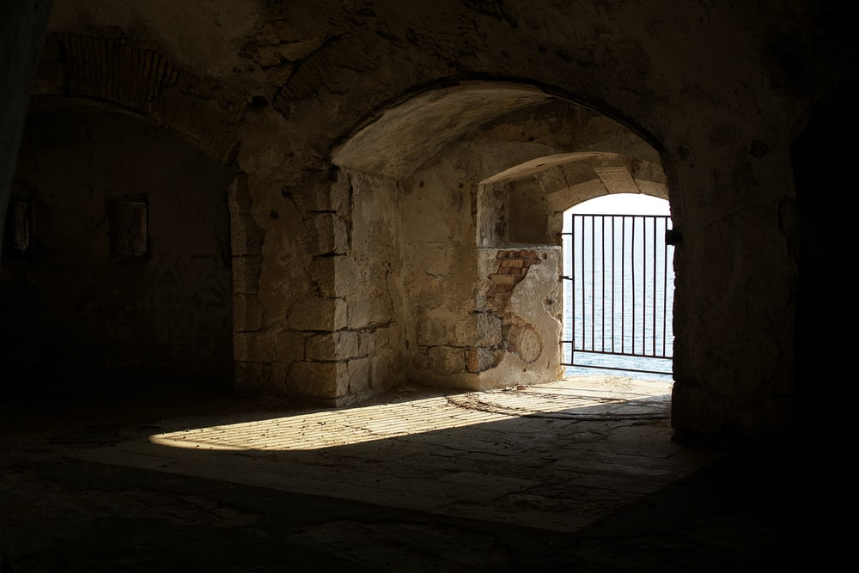
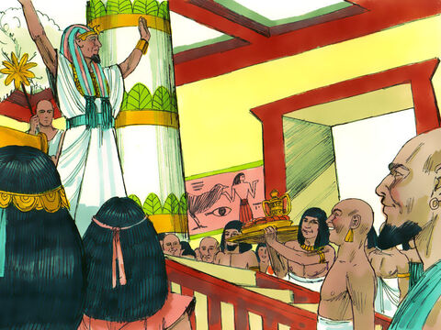
‘Joseph the Dreamer’
META-MORPHOSIS JUVENILE REHABILITATION PROGRAM ™
A young man thrown into prison for 13 years and surfaced Governor of Egypt.
A story of attitude and forgiveness.
Class 10
Notes:
Narration: Bible Study 10
? Is there an evil force behind all of the negative actions on our planet
What will happen to me after I die?
Am I all alone?
These are questions on all of our minds at some time or another. There are those that believe in creationism versus evolutionism? The answers to all of these questions are in the Bible.

Slide 2
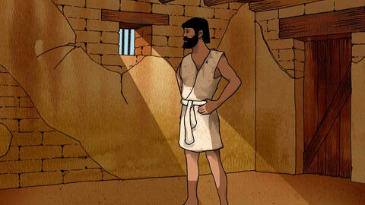
Joseph “From a Dreamer to Governor”
Notes:
Narrative:

Slide 3
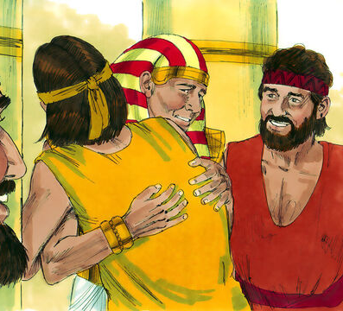
Joseph revealed himself to his brothers
Notes:
Narrative:
TEXT: Genesis 45 1-28
Joseph Revealed to His Brothers Then Joseph could not restrain himself before all those who stood by him, and he cried out, “Make everyone go out from me!” So no one stood with him while Joseph made himself known to his brothers. And he wept aloud, and the Egyptians and the house of Pharaoh heard it. Then Joseph said to his brothers, “I am Joseph; does my father still live?” But his brothers could not answer him, for they were dismayed in his presence.

Slide 4
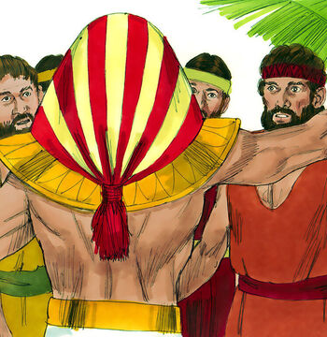
Joseph told his brothers not to fret, as it was God’s will that he ended up where he is now
Notes:
Narrative:
And Joseph said to his brothers, “Please come near to me.” So they came near. Then he said: “I am Joseph your brother, whom you sold into Egypt. But now, do not therefore be grieved or angry with yourselves because you sold me here; for God sent me before you to preserve life. For these two years the famine has been in the land, and there are still five years in which there will be neither plowing nor harvesting. And God sent me before you to preserve a posterity for you in the earth, and to save your lives by a great deliverance. So now it was not you who sent me here, but God; and He has made me a father to Pharaoh, and lord of all his house, and a ruler throughout all the land of Egypt.

Slide 5
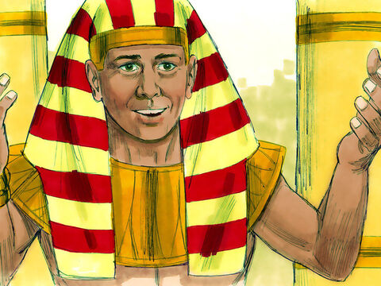
Joseph tells his brothers to bring their father as they can dwell near to him
Notes:
Narrative:
“Hurry and go up to my father, and say to him Thus says your son Joseph: “God has made me lord of all Egypt; come down to me, do not tarry. You shall dwell in the land of Goshen, and you shall be near to me, you and your children, your children’s children, your flocks and your herds, and all that you have. There I will provide for you, lest you and your household, and all that you have, come to poverty; for there are still five years of famine “And behold, your eyes and the eyes of my brother Benjamin see that it is my mouth that speaks to you. So you shall tell my father of all my glory in Egypt, and of all that you have seen; and you shall hurry and bring my father down here.” Then he fell on his brother Benjamin’s neck and wept, and Benjamin wept on his neck.

Slide 6
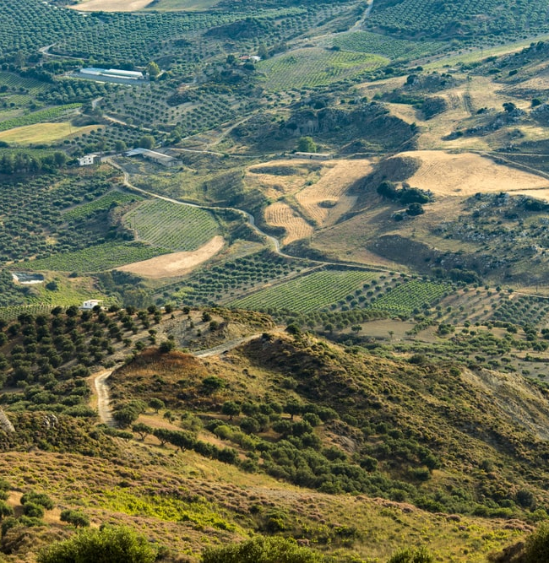
Pharaoh made sure Joseph’s family was given the best land of Egypt
Notes:
Narrative:
Moreover he kissed all his brothers and wept over them, and after that his brothers talked with him. Now the report of it was heard in Pharaoh’s house, saying, “Joseph’s brothers have come.” So it pleased Pharaoh and his servants well. And Pharaoh said to Joseph, “Say to your brothers, Do this: Load your animals and depart; go to the land of Canaan. Bring your father and your households and come to me; I will give you the best of the land of Egypt, and you will eat the fat of the land.
Now you are commanded—do this: Take carts out of the land of Egypt for your little ones and your wives; bring your father and come. Also do not be concerned about your goods, for the best of all the land of Egypt is yours.” Then the sons of Israel did so; and Joseph gave them carts according to the command of Pharaoh, and he gave them provisions for the journey. He gave to all of them, to each man, changes of garments; but to Benjamin he gave three hundred pieces of silver and five changes of garments.

Slide 7
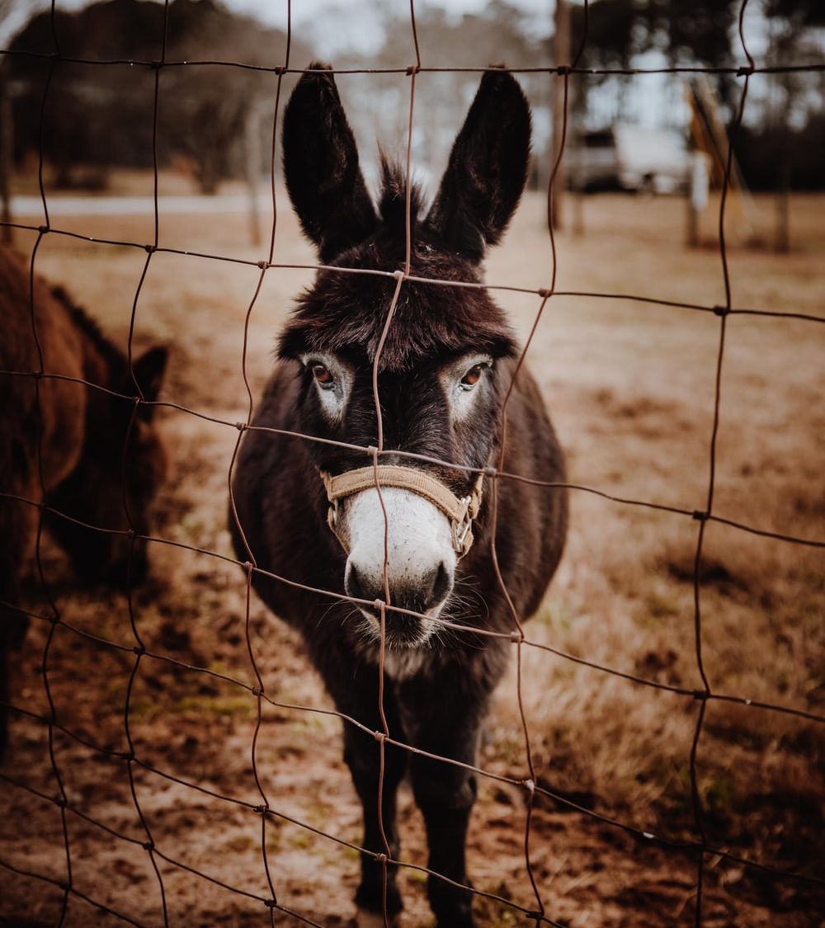
Joseph sent his father donkeys loaded with good things
Notes:
Narrative:
And he sent to his father these things: ten donkeys loaded with the good things of Egypt, and ten female donkeys loaded with grain, bread, and food for his father for the journey. So he sent his brothers away, and they departed; and he said to them, “See that you do not become troubled along the way.”

Slide 8
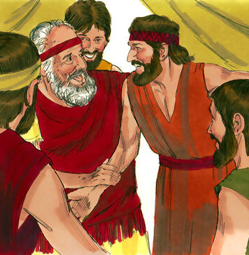
The brothers left and told Jacob of all they had found out
Notes:
Narrative:
Then they went up out of Egypt, and came to the land of Canaan to Jacob their father. And they told him, saying, “Joseph is still alive, and he is governor over all the land of Egypt” And Jacob’s heart stood still, because he did not believe them. But when they told him all the words which Joseph had said to them, and when he saw the carts which Joseph had sent to carry him, the spirit of Jacob their father revived.

Slide 9
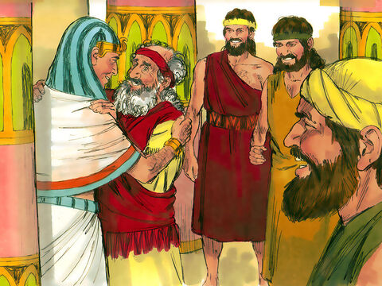
Jacob vowed to see Joseph before he died
Notes:
Narration:
Then Israel said, “It is enough. Joseph my son is still alive. I will go and see him before I die.”

Slide 10
Group Discussion
1. Years of prison and alienation from his family brought Joseph to an overwhelming state. He could have killed his brothers he had the power to do that. Why was this better for him?
2. What would killing them have done to the destiny of the Jewish nation?
3. Pharaoh was glad to hear of Joseph’s family. When you are in right standing with God, you have favor with people. How can you get into right standing with God?
4. Do you believe if you start to make the right decisions that God will make your life right again?
5. Can you feel the power of God calling to you?
Notes:
Narrative Group Discussion
Break into groups of 4 and discuss the following questions.
Please Note:
Only give them one question at a time, after they have had adequate time to discuss, move to the next question.
. Years of prison and alienation from his family brought Joseph to an overwhelming state. He could have killed his brothers he had the power to do that. Why was this better for him?
2. What would killing them have done to the destiny of the Jewish nation?
3. Pharaoh was glad to hear of Joseph’s family. When you are in right standing with God, you have favor with people. How can you get into right standing with God?
4. Do you believe if you start to make the right decisions that God will make your life right again?
5. Can you feel the power of God calling to you?
6. When Jacob’s brothers were young, they made bad decisions. Now they were changing. Why is it important to do things right?
7. You will encounter laws every where you go. What are the consequences of breaking laws?
8. What are the consequences of breaking God’s laws?
9. God will always try to enter your life and help you. Why?
10. Jacob hears what the brothers are saying. Why doesn’t he believe them?
Come back to a whole group and re-ask the same questions and see if anyone wants to share their thoughts.

Slide 11
Group Discussion
6. When Jacob’s brothers were young, they made bad decisions. Now they were changing. Why is it important to do things right?
7. You will encounter laws every where you go. What are the consequences of breaking laws?
8. What are the consequences of breaking God’s laws?
9. God will always try to enter your life and help you. Why?
10. Jacob hears what the brothers are saying. Why doesn’t he believe them?

Slide 12
References
https://images.unsplash.com/photo-1599431148111-aed6c9607a0f?ixid=MnwxMjA3fDB8MHxwaG90by1wYWdlfHx8fGVufDB8fHx8&ixlib=rb-1.2.1&auto=format&fit=crop&w=1050&q=80
https://media.freebibleimages.org/stories/FB_Joseph_Prison_Dreams/overview-thumbnails/009-joseph-prison-dreams.jpg?1613595453
https://media.freebibleimages.org/stories/FB_Joseph_Reunion/overview-thumbnails/017-joseph-reunion.jpg?1613595467
https://media.freebibleimages.org/stories/FB_Joseph_Reunion/overview-thumbnails/016-joseph-reunion.jpg?1613595467
https://media.freebibleimages.org/stories/FB_Joseph_Reunion/overview-thumbnails/015-joseph-reunion.jpg?1613595467
https://images.unsplash.com/photo-1470165730317-b0f82e73778a?ixid=MnwxMjA3fDB8MHxwaG90by1wYWdlfHx8fGVufDB8fHx8&ixlib=rb-1.2.1&auto=format&fit=crop&w=1050&q=80
https://images.unsplash.com/photo-1610309098035-b80aa9b07be6?ixid=MnwxMjA3fDB8MHxzZWFyY2h8NDB8fGRvbmtleXN8ZW58MHx8MHx8&ixlib=rb-1.2.1&auto=format&fit=crop&w=800&q=60
https://media.freebibleimages.org/stories/FB_Joseph_Reunion/overview-thumbnails/019-joseph-reunion.jpg?1613595467
https://media.freebibleimages.org/stories/FB_Joseph_Reunion/overview-thumbnails/021-joseph-reunion.jpg?1613595467
https://media.freebibleimages.org/stories/FB_YO_Joseph_Prison/overview-thumbnails/012-yo-joseph-prison.jpg?1613597975

Slide 13
Original Narrative
Notes:
Narrative:
TEXT: Genesis 45 1-28
Joseph Revealed to His Brothers Then Joseph could not restrain himself before all those who stood by him, and he cried out, “Make everyone go out from me!” So no one stood with him while Joseph made himself known to his brothers. And he wept aloud, and the Egyptians and the house of Pharaoh heard it. Then Joseph said to his brothers, “I am Joseph; does my father still live?” But his brothers could not answer him, for they were dismayed in his presence.
And Joseph said to his brothers, “Please come near to me.” So they came near. Then he said: “I am Joseph your brother, whom you sold into Egypt. But now, do not therefore be grieved or angry with yourselves because you sold me here; for God sent me before you to preserve life. For these two years the famine has been in the land, and there are still five years in which there will be neither plowing nor harvesting. And God sent me before you to preserve a posterity for you in the earth, and to save your lives by a great deliverance. So now it was not you who sent me here, but God; and He has made me a father to Pharaoh, and lord of all his house, and a ruler throughout all the land of Egypt. “Hurry and go up to my father, and say to him Thus says your son Joseph: “God has made me lord of all Egypt; come down to me, do not tarry. You shall dwell in the land of Goshen, and you shall be near to me, you and your children, your children’s children, your flocks and your herds, and all that you have. There I will provide for you, lest you and your household, and all that you have, come to poverty; for there are still five years of famine “And behold, your eyes and the eyes of my brother Benjamin see that it is my mouth that speaks to you. So you shall tell my father of all my glory in Egypt, and of all that you have seen; and you shall hurry and bring my father down here.” Then he fell on his brother Benjamin’s neck and wept, and Benjamin wept on his neck.
Moreover he kissed all his brothers and wept over them, and after that his brothers talked with him. Now the report of it was heard in Pharaoh’s house, saying, “Joseph’s brothers have come.” So it pleased Pharaoh and his servants well. And Pharaoh said to Joseph, “Say to your brothers, Do this: Load your animals and depart; go to the land of Canaan. Bring your father and your households and come to me; I will give you the best of the land of Egypt, and you will eat the fat of the land.
Now you are commanded—do this: Take carts out of the land of Egypt for your little ones and your wives; bring your father and come. Also do not be concerned about your goods, for the best of all the land of Egypt is yours.” Then the sons of Israel did so; and Joseph gave them carts according to the command of Pharaoh, and he gave them provisions for the journey. He gave to all of them, to each man, changes of garments; but to Benjamin he gave three hundred pieces of silver and five changes of garments.
And he sent to his father these things: ten donkeys loaded with the good things of Egypt, and ten female donkeys loaded with grain, bread, and food for his father for the journey. So he sent his brothers away, and they departed; and he said to them, “See that you do not become troubled along the way.” Then they went up out of Egypt, and came to the land of Canaan to Jacob their father. And they told him, saying, “Joseph is still alive, and he is governor over all the land of Egypt” And Jacob’s heart stood still, because he did not believe them. But when they told him all the words which Joseph had said to them, and when he saw the carts which Joseph had sent to carry him, the spirit of Jacob their father revived. Then Israel said, “It is enough. Joseph my son is still alive. I will go and see him before I die.”
Meta-Morphosis5 5/17/08
A commitment and vision for the future through peremptory development of youth Cheryl K Langford
GROUP STUDY QUESTIONS
1. Years of prison and alienation from his family brought Joseph to an overwhelming state. He could have killed his brothers he had the power to do that. Why was this better for him?
2. What would killing them have done to the destiny of the Jewish nation?
3. Pharaoh was glad to hear of Joseph’s family. When you are in right standing with God, you have favor with people. How can you get into right standing with God?
4. Do you believe if you start to make the right decisions that God will make your life right again?
5. Can you feel the power of God calling to you?
6. When Jacob’s brothers were young, they made bad decisions. Now they were changing. Why is it important to do things right?
7. You will encounter laws every where you go. What are the consequences of breaking laws?
8. What are the consequences of breaking God’s laws?
9. God will always try to enter your life and help you. Why?
10. Jacob hears what the brothers are saying. Why doesn’t he believe them?

