Slide 1
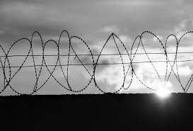
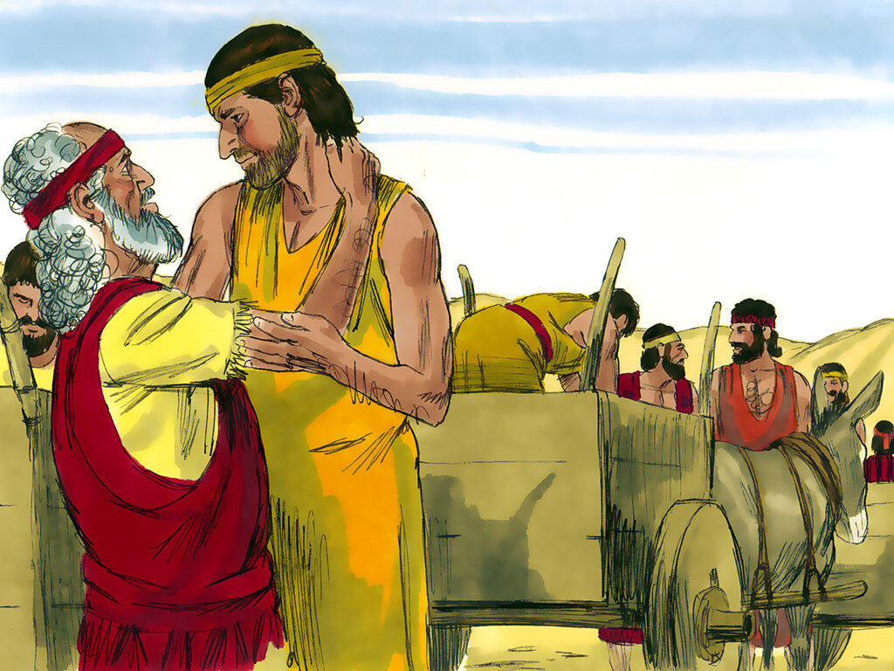
‘Joseph the Dreamer’
META-MORPHOSIS JUVENILE REHABILITATION PROGRAM ™
A young man thrown into prison for 13 years and surfaced Governor of Egypt.
A story of attitude and forgiveness.
Class 5
Notes:
Narration: Bible Study 5
? Is there an evil force behind all of the negative actions on our planet
What will happen to me after I die?
Am I all alone?
These are questions on all of our minds at some time or another. There are those that believe in creationism versus evolutionism? The answers to all of these questions are in the Bible.

Slide 2
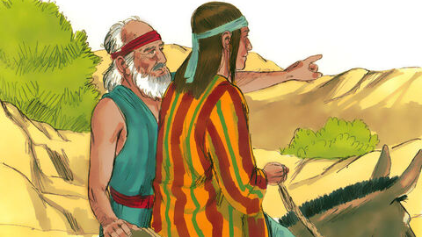
“From a Dreamer to Governor”
Notes:
Narrative

Slide 3
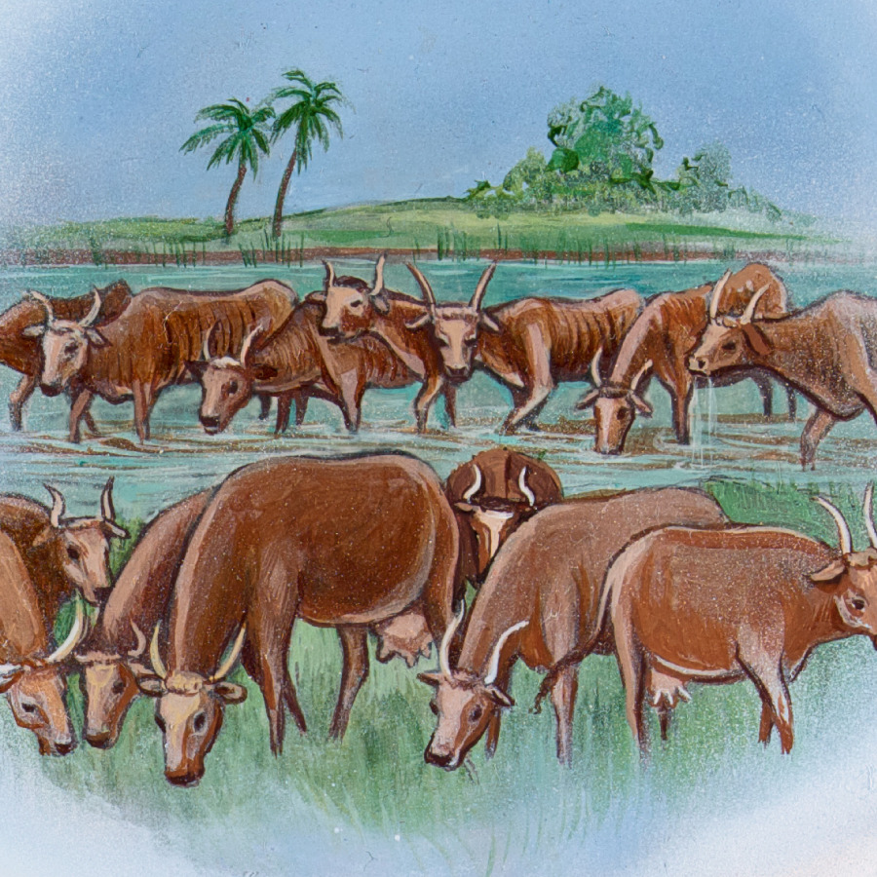
Pharaoh’s first dream
Notes:
Narrative
TEXT: Genesis 41 1- 36
Pharaoh’s Dreams
Then it came to pass, at the end of two full years, that Pharaoh had a dream; and behold, he stood by the river. Suddenly there came up out of the river seven cows, fine looking and fat; and they fed in the meadow. Then behold, seven other cows came up after them out of the river, ugly and gaunt, and stood by the other cows on the bank of the river. And the ugly and gaunt cows ate up the seven fine looking and fat cows. So Pharaoh awoke.

Slide 4
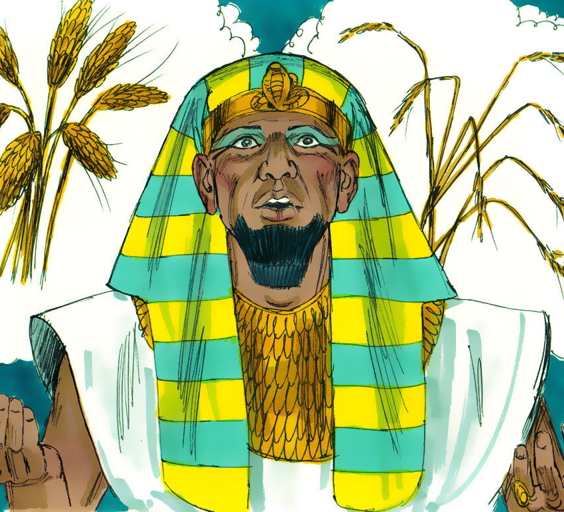
Pharaoh’s second dream
Notes:
Narrative
He slept and dreamed a second time; and suddenly seven heads of grain came up on one stalk, plump and good. Then behold, seven thin heads, blighted by the east wind, sprang up after them. And the seven thin heads devoured the seven plump and full heads. So Pharaoh awoke, and indeed, it was a dream.

Slide 5
The Butler refers Joseph to Pharaoh
Notes:
Narrative
Now it came to pass in the morning that his spirit was troubled, and he sent and called for all the magicians of Egypt and all its wise men. And Pharaoh told them his dreams, but there was no one who could interpret them for Pharaoh. Then the chief butler spoke to Pharaoh, saying: “I remember my faults this day. When Pharaoh was angry with his servants, and put me in custody in the house of the captain of the guard, both me and the chief baker, we each had a dream in one night, he and I. Each of us dreamed according to the interpretation of his own dream.
Now there was a young Hebrew man with us there, a servant of the captain of the guard. And we told him, and he interpreted our dreams for us; to each man he interpreted according to his own dream. And it came to pass, just as he interpreted for us, so it happened. He restored me to my office, and he hanged him.”
Then Pharaoh sent and called Joseph, and they brought him quickly out of the dungeon; and he shaved, changed his clothing, and came to Pharaoh. And Pharaoh said to Joseph, “I have had a dream, and there is no one who can interpret it. But I have heard it said of you that you can understand a dream, to interpret it.” So Joseph answered Pharaoh, saying, “It is not in me; God will give Pharaoh an answer of peace.”

Slide 6
Pharaoh explains his dreams to Joseph
Notes:
Narrative
Then Pharaoh said to Joseph: “Behold, in my dream I stood on the bank of the river. Suddenly seven cows came up out of the river, fine looking and fat; and they fed in the meadow. Then behold, seven other cows came up after them, poor and very ugly and gaunt, such ugliness as I have never seen in all the land of Egypt. And the gaunt and ugly cows ate up the first seven, the fat cows. When they had eaten them up, no one would have known that they had eaten them, for they were just as ugly as at the beginning. So I awoke.
Also I saw in my dream, and suddenly seven heads came up on one stalk, full and good. Then behold, seven heads, withered, thin, and blighted by the east wind, sprang up after them. And the thin heads devoured the seven good heads. So I told this to the magicians, but there was no one who could explain it to me.”

Slide 7
Joseph interprets Pharaoh’s dreams as 7 years of plenty and 7 of famine
Notes:
Narrative
Then Joseph said to Pharaoh, “The dreams of Pharaoh are one; God has shown Pharaoh what He is about to do: The seven good cows are seven years, and the seven good heads are seven years; the dreams are one. And the seven thin and ugly cows which came up after them are seven years, and the seven empty heads blighted by the east wind are seven years of famine. This is the thing which I have spoken to Pharaoh. God has shown Pharaoh what He is about to do.
Indeed seven years of great plenty will come throughout all the land of Egypt; but after them seven years of famine will arise, and all the plenty will be forgotten in the land of Egypt; and the famine will deplete the land. So the plenty will not be known in the land because of the famine following, for it will be very severe. And the dream was repeated to Pharaoh twice because the thing is established by God, and God will shortly bring it to pass.

Slide 8
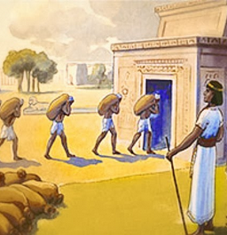
Joseph suggests how Pharaoh can prepare
Notes:
Narrative
“Now therefore, let Pharaoh select a discerning and wise man, and set him over the land of Egypt. Let Pharaoh do this, and let him appoint officers over the land, to collect one-fifth of the produce of the land of Egypt in the seven plentiful years. And let them gather all the food of those good years that are coming, and store up grain under the authority of Pharaoh, and let them keep food in the cities. Then that food shall be as a reserve for the land for the seven years of famine which shall be in the land of Egypt that the land may not perish during the famine.”

Slide 9
Group Discussion
1. Joseph interpreted the dreams of Pharaoh, how do you think that was possible?
2. What did God do for Joseph in his life to enable him to have this gift of dream interpretation?
3. What did Joseph do after he interpreted the dream?
4. What gift of the Holy Spirit is this? (Word of wisdom) It goes beyond human wisdom.
5. Joseph had to wait for two more years to come before Pharaoh. God could have given Pharaoh the dream shortly after the butler was released from prison. Talk about some reasons why you think God waited for two years?
Notes:
Narrative Group Discussion
Break into groups of 4 and discuss the following questions.
Please Note:
Only give them one question at a time, after they have had adequate time to discuss, move to the next question.
Joseph interpreted the dreams of Pharaoh, how do you think that was possible?
What did God do for Joseph in his life to enable him to have this gift of dream interpretation?
What did Joseph do after he interpreted the dream?
What gift of the Holy Spirit is this? (Word of wisdom) It goes beyond human wisdom.
Joseph had to wait for two more years to come before Pharaoh. God could have given Pharaoh the dream shortly after the butler was released from prison. Talk about some reasons why you think God waited for two years?
Have you ever had a dream more than once?
Why do you think we have dreams that stand out in our minds?
What is the supernal part of our being and what role does it play in our lives? (The supernal part of our being is the highest part, it is the God part, it is the part of us that calls us to look at areas of our lives that need to be addressed. It is the Holy Spirit of God.)
Come back to a whole group and re-ask the same questions and see if anyone wants to share their thoughts.

Slide 10
Group Discussion
6. Have you ever had a dream more than once?
7. Why do you think we have dreams that stand out in our minds?
8. What is the supernal part of our being and what role does it play in our lives? (The supernal part of our being is the highest part, it is the God part, it is the part of us that calls us to look at areas of our lives that need to be addressed. It is the Holy Spirit of God.)

Slide 11
References
https://media.freebibleimages.org/stories/FB_Joseph_Pit/overview-thumbnails/002-joseph-pit.jpg?1613595446
https://assetsnffrgf-a.akamaihd.net/assets/m/1101978076/univ/art/1101978076_univ_cnt_2_xl.jpg
https://media.freebibleimages.org/stories/FB_Joseph_Pharaoh_Dreams/overview-images/006-joseph-pharaoh-dreams.jpg?1613595454
https://1.bp.blogspot.com/-3rehoPRzAKo/Vp6Nn1bQaaI/AAAAAAAAeQA/pLRPWICySn8/s1600/Joseph%2Bbefore%2BPharaoh.jpg
https://media.freebibleimages.org/stories/FB_Joseph_Pharaoh_Dreams/overview-images/005-joseph-pharaoh-dreams.jpg?1613595454
https://media.freebibleimages.org/stories/FB_Joseph_Pharaoh_Dreams/overview-images/002-joseph-pharaoh-dreams.jpg?1613595454
http://4.bp.blogspot.com/-e2P2yZ-Z1UE/VVI72BzlbtI/AAAAAAAABFw/cJY6hr8FrAY/s1600/GN%2B42.1.PNG
https://encrypted-tbn0.gstatic.com/images?q=tbn:ANd9GcQZ9sejYkGq-QTxjB_yOc9xc-BtIb3AjPj-CA&usqp=CAU
https://media.freebibleimages.org/stories/FB_Joseph_Reunion/overview-images/001-joseph-reunion.jpg?1613595463

Slide 12
Original Narrative
Notes:
Narrative:
TEXT: Genesis 41 1- 36
Pharaoh’s Dreams
Then it came to pass, at the end of two full years, that Pharaoh had a dream; and behold, he stood by the river. Suddenly there came up out of the river seven cows, fine looking and fat; and they fed in the meadow. Then behold, seven other cows came up after them out of the river, ugly and gaunt, and stood by the other cows on the bank of the river. And the ugly and gaunt cows ate up the seven fine looking and fat cows. So Pharaoh awoke.
He slept and dreamed a second time; and suddenly seven heads of grain came up on one stalk, plump and good. Then behold, seven thin heads, blighted by the east wind, sprang up after them. And the seven thin heads devoured the seven plump and full heads. So Pharaoh awoke, and indeed, it was a dream.
Now it came to pass in the morning that his spirit was troubled, and he sent and called for all the magicians of Egypt and all its wise men. And Pharaoh told them his dreams, but there was no one who could interpret them for Pharaoh. Then the chief butler spoke to Pharaoh, saying: “I remember my faults this day. When Pharaoh was angry with his servants, and put me in custody in the house of the captain of the guard, both me and the chief baker, we each had a dream in one night, he and I. Each of us dreamed according to the interpretation of his own dream.
Now there was a young Hebrew man with us there, a servant of the captain of the guard. And we told him, and he interpreted our dreams for us; to each man he interpreted according to his own dream. And it came to pass, just as he interpreted for us, so it happened. He restored me to my office, and he hanged him.”
Then Pharaoh sent and called Joseph, and they brought him quickly out of the dungeon; and he shaved, changed his clothing, and came to Pharaoh. And Pharaoh said to Joseph, “I have had a dream, and there is no one who can interpret it. But I have heard it said of you that you can understand a dream, to interpret it.” So Joseph answered Pharaoh, saying, “It is not in me; God will give Pharaoh an answer of peace.”
Then Pharaoh said to Joseph: “Behold, in my dream I stood on the bank of the river. Suddenly seven cows came up out of the river, fine looking and fat; and they fed in the meadow. Then behold, seven other cows came up after them, poor and very ugly and gaunt, such ugliness as I have never seen in all the land of Egypt. And the gaunt and ugly cows ate up the first seven, the fat cows. When they had eaten them up, no one would have known that they had eaten them, for they were just as ugly as at the beginning. So I awoke.
Also I saw in my dream, and suddenly seven heads came up on one stalk, full and good. Then behold, seven heads, withered, thin, and blighted by the east wind, sprang up after them. And the thin heads devoured the seven good heads. So I told this to the magicians, but there was no one who could explain it to me.”
Then Joseph said to Pharaoh, “The dreams of Pharaoh are one; God has shown Pharaoh what He is about to do: The seven good cows are seven years, and the seven good heads are seven years; the dreams are one. And the seven thin and ugly cows which came up after them are seven years, and the seven empty heads blighted by the east wind are seven years of famine. This is the thing which I have spoken to Pharaoh. God has shown Pharaoh what He is about to do.
Indeed seven years of great plenty will come throughout all the land of Egypt; but after them seven years of famine will arise, and all the plenty will be forgotten in the land of Egypt; and the famine will deplete the land. So the plenty will not be known in the land because of the famine following, for it will be very severe. And the dream was repeated to Pharaoh twice because the thing is established by God, and God will shortly bring it to pass.
“Now therefore, let Pharaoh select a discerning and wise man, and set him over the land of Egypt. Let Pharaoh do this, and let him appoint officers over the land, to collect one-fifth of the produce of the land of Egypt in the seven plentiful years. And let them gather all the food of those good years that are coming, and store up grain under the authority of Pharaoh, and let them keep food in the cities. Then that food shall be as a reserve for the land for the seven years of famine which shall be in the land of Egypt that the land may not perish during the famine.”
STUDY GROUP QUESTIONS
Joseph interpreted the dreams of Pharaoh, how do you think that was possible?
What did God do for Joseph in his life to enable him to have this gift of dream interpretation?
What did Joseph do after he interpreted the dream?
What gift of the Holy Spirit is this? (Word of wisdom) It goes beyond human wisdom.
Joseph had to wait for two more years to come before Pharaoh. God could have given Pharaoh the dream shortly after the butler was released from prison. Talk about some reasons why you think God waited for two years?
Have you ever had a dream more than once?
Why do you think we have dreams that stand out in our minds?
What is the supernal part of our being and what role does it play in our lives? (The supernal part of our being is the highest part, it is the God part, it is the part of us that calls us to look at areas of our lives that need to be addressed. It is the Holy Spirit of God.)

