Slide 1
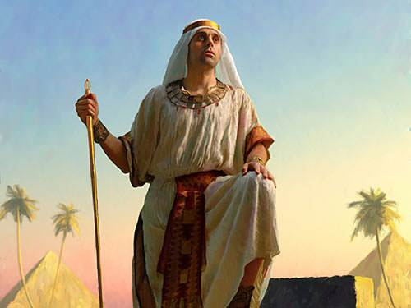
‘Joseph the Dreamer’
META-MORPHOSIS JUVENILE REHABILITATION PROGRAM ™
A young man thrown into prison for 13 years and surfaced Governor of Egypt.
A story of attitude and forgiveness.
Class 1
Notes:
Narration: Please read the slide an move to slide 2

Slide 2
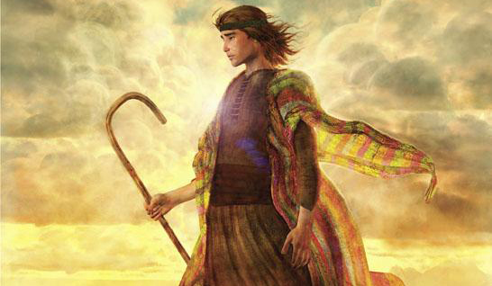
Joseph “From a Prisoner to Governor”
Notes:
Narrative:
In these next few weeks we will discuss the story of Joseph and how this relates to your life.

Slide 3
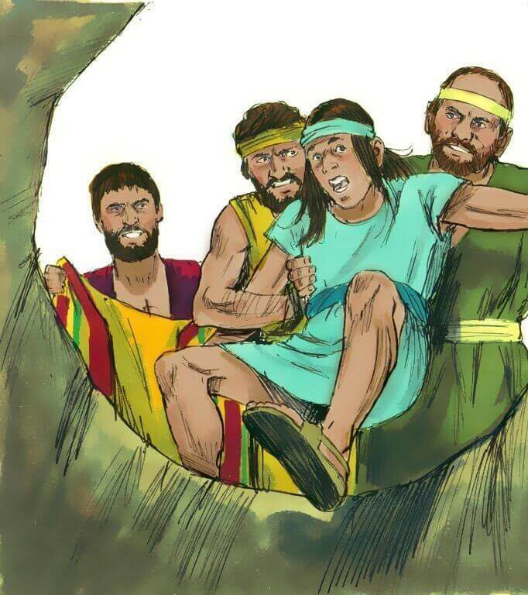
Joseph as a Child
It’s a story of how a god attitude, trust in God, and forgiveness can bring a man to greatness. We all have this potential.
Notes:
Narrative:
TEXT: GENISIS 37 1-11
This story is about a young man who was sold into slavery by his own brothers. He later was thrown into prison for 13 years and surfaced as Governor of Egypt. It is a story of how a god attitude, trust in God, and forgiveness can bring a man to greatness. And we all have this potential.

Slide 4
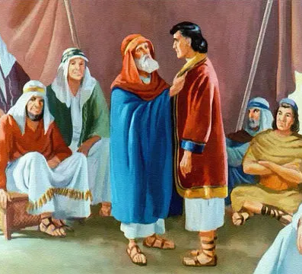
Jacob’s Sons
Notes:
Narrative:
And the Story begins:
And Jacob dwelt in the land where his father Isaac was a stranger. That land was called Canaan.
These are the generations of Jacob.
Joseph, being seventeen years old, was feeding the flock with his brothers; and he was with the sons of Billah and with the sons of Zilpah, who were his father’s lesser wives.
Billah and Zilpah were Isaacs wives. Joseph ran to his father and gave him an evil report about his brothers

Slide 5
Joseph’s Coat
Notes:
Narrative:
Now Joseph’s father loved him more than all of his children because he was the son of his old age and he loved Joseph’s mother Rachel more than all his wives. Joseph’s father made him a coat of many colors and when his brother saw that their father loved Joseph more than them, they hated him, and found it hard to speak to him peaceably.

Slide 6
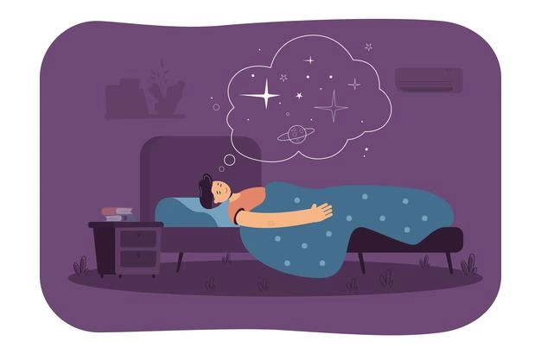
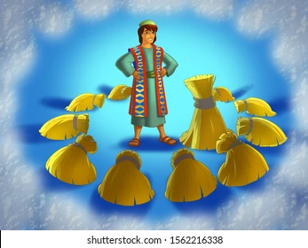
Joseph’s Dream
Notes:
Narrative:
One night Joseph dreamed a dream and he told it to his brothers and when they heard the dream they hated him even more.
And he said to them Hear I pray, and listen to this dream I dreamed:
Behold, we were binding sheaves in the field and my sheaf arose up and stood upright; and behold, your sheaves stood around about me, and made obeisance to my sheaf. (Obeisance means that they bowed down in honor).
And his brothers said to him, Will you indeed rule over us? Or will you have dominion over us? And they hated him even more for his dreams and for his words that he spoke to them.

Slide 7
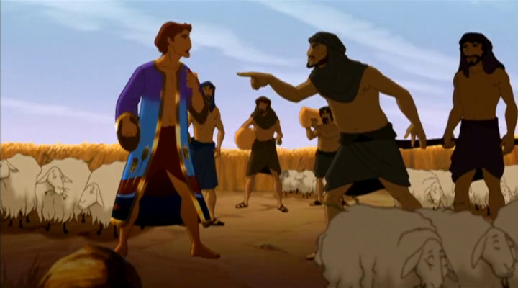
Joseph’s 2nd Dream
Notes:
Narrative:
Then Joseph dreamed another dream and he told this dream to his brothers also. He said “Behold the sun and the moon and the eleven stars made obeisance to me”.
This dream Joseph told to his father; and to his family: and his father rebuked him, and said unto him, what is this dream that you have dreamed? Shall I and thy mother and thy family indeed come to bow down ourselves to thee in the earth?
And his family envied him; but his father observed the saying. (He wondered what it could mean)

Slide 8
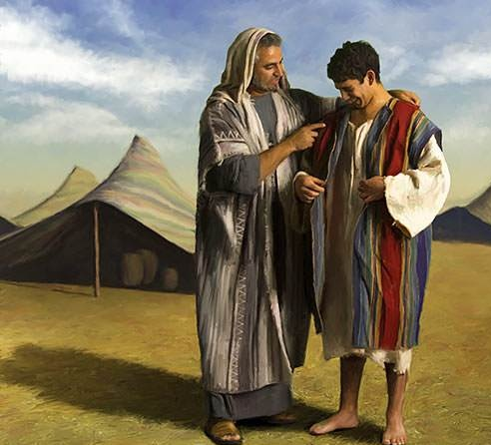
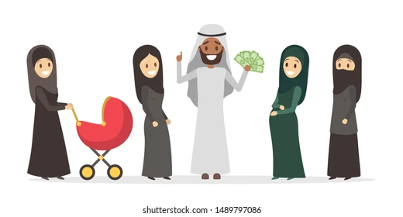
Unraveling the Story
Jacob and his multiple wives
Joseph is Jacob’s favorite
Joseph is a dreamer
Notes:
Narrative:
Let’s begin to unravel this story:
This was a time in history when multiple wives were an acceptable practice in their culture. It is not acceptable in this day, and surely we can see the problems that can arise from multiple wives and families living together in one household.
Joseph’s mother Rachel was the love of Isaac’s life. So he favored Joseph more. Joseph was a dreamer.

Slide 9
Group Discussion
1. Are you a Dreamer?
2. Why do you think Joseph’s brother hated him?
3. Can you think of someone you know that is like Joseph, (A favored child) or are you like Joseph?
4. Do you think Joseph was purposely trying to anger his family by sharing his dreams?
5. Do you think Joseph was immature and should have kept these things to himself, after all he was only seventeen years old?
6. We know that God communicates to people in dreams, have you ever had
a dream that you can’t forget?
Notes:
Narrative Group Discussion
Break into groups of 4 and discuss the following questions.
Please Note:
Only give them one question at a time, after they have had adequate time to discuss, move to the next question.
STUDY GROUP QUESTIONS:
1. Are you a Dreamer?
2. Why do you think Joseph’s brother hated him?
3. Can you think of someone you know that is like Joseph, (A favored child) or are you like Joseph?
4. Do you think Joseph was purposely trying to anger his family by sharing his dreams?
5. Do you think Joseph was immature and should have kept these things to himself, after all he was only seventeen years old?
6. We know that God communicates to people in dreams, have you ever had
a dream that you can’t forget?
7. Have you ever had a dream that you felt was a warning?
8. How else does God communicate with us?
9. Have you ever had a dream that you felt was unusual like Joseph’s dream?
10. Would you like to know why you were born?
11. Who can answer that question for you?

Slide 10
Group Discussion
7. Have you ever had a dream that you felt was a warning?
8. How else does God communicate with us?
9. Have you ever had a dream that you felt was unusual like Joseph’s dream?
10. Would you like to know why you were born?
11. Who can answer that question for you?

Slide 11
References
https://lh3.googleusercontent.com/proxy/iHI2nzh5dCxPgON0pmMgUd2TV0Pnamx9Fp3tPhI_wBX5-JMlyr9NAWt0LaLBuF7MUT19JifjGoB5_Vu57XoCQs4Obt-3zLpIgPjSl0AoZxBmiZbM
https://i0.wp.com/dianaleaghmatthews.com/wp-content/uploads/2019/05/011-moody-joseph.jpg?fit=480%2C360
https://image.shutterstock.com/image-illustration/bible-pictures-josephs-coat-dreams-260nw-1562216338.jpg
https://img.freepik.com/free-vector/peaceful-man-sleeping-bedroom-resting-bed-dreaming-space-cartoon-illustration_74855-14477.jpg?size=626&ext=jpg
https://image.shutterstock.com/image-vector/bible-joseph-son-israel-dreams-260nw-224505613.jpg
https://www.thehunchblog.com/wp-content/uploads/2015/01/Joseph-2.png
https://image.shutterstock.com/image-illustration/polygamy-arabic-family-girl-hijab-260nw-1489797086.jpg
https://qph.fs.quoracdn.net/main-qimg-711f43d086aaf2e276c6852b8d11ad62
https://w2.chabad.org/media/images/922/lamb9226295.jpg
http://ubdavid.org/bible/characters1/graphics/6_title.jpg
https://www.theologyofwork.org/uploads/made/uploads/general/1009/jail_524_264_80_s_c1.jpg

Slide 12
Original Narrative
Notes:
Narrative:
JOSEPH
“FROM A PRISONER TO GOVERNOR”
In these next few weeks we will discuss the story of Joseph and how this relates to your life.
TEXT: GENISIS 37 1-11
Joseph as a child
This story is about a young man who was sold into slavery by his own brothers. He later was thrown into prison for 13 years and surfaced as Governor of Egypt. It is a story of how a god attitude, trust in God, and forgiveness can bring a man to greatness. And we all have this potential.
And the Story begins:
And Jacob dwelt in the land where his father Isaac was a stranger. That land was called Canaan.
These are the generations of Jacob.
Joseph, being seventeen years old, was feeding the flock with his brothers; and he was with the sons of Billah and with the sons of Zilpah, who were his father’s lesser wives.
Billah and Zilpah were Isaacs wives. Joseph ran to his father and gave him an evil report about his brothers.
Now Joseph’s father loved him more than all of his children because he was the son of his old age and he loved Joseph’s mother Rachel more than all his wives. Joseph’s father made him a coat of many colors and when his brother saw that their father loved Joseph more than them, they hated him, and found it hard to speak to him peaceably.
One night Joseph dreamed a dream and he told it to his brothers and when they heard the dream they hated him even more.
And he said to them Hear I pray, and listen to this dream I dreamed:
Behold, we were binding sheaves in the field and my sheaf arose up and stood upright; and behold, your sheaves stood around about me, and made obeisance to my sheaf. (Obeisance means that they bowed down in honor).
And his brothers said to him, Will you indeed rule over us? Or will you have dominion over us? And they hated him even more for his dreams and for his words that he spoke to them.
Then Joseph dreamed another dream and he told this dream to his brothers also. He said “Behold the sun and the moon and the eleven stars made obeisance to me”.
This dream Joseph told to his father; and to his family: and his father rebuked him, and said unto him, what is this dream that you have dreamed? Shall I and thy mother and thy family indeed come to bow down ourselves to thee in the earth?
And his family envied him; but his father observed the saying. (He wondered what it could mean)
Let’s begin to unravel this story:
This was a time in history when multiple wives were an acceptable practice in their culture. It is not acceptable in this day, and surely we can see the problems that can arise from multiple wives and families living together in one household.
Joseph’s mother Rachel was the love of Isaac’s life. So he favored Joseph more. Joseph was a dreamer.
STUDY GROUP QUESTIONS:
1. Are you a Dreamer?
2. Why do you think Joseph’s brother hated him?
3. Can you think of someone you know that is like Joseph, (A favored child) or are you like Joseph?
4. Do you think Joseph was purposely trying to anger his family by sharing his dreams?
5. Do you think Joseph was immature and should have kept these things to himself, after all he was only seventeen years old?
6. We know that God communicates to people in dreams, have you ever had
a dream that you can’t forget?
7. Have you ever had a dream that you felt was a warning?
8. How else does God communicate with us?
9. Have you ever had a dream that you felt was unusual like Joseph’s dream?
10. Would you like to know why you were born?
11. Who can answer that question for you?

